Slide 1
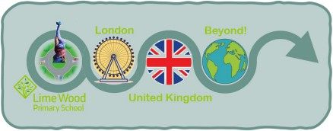




Year 2 Curriculum Overview – Summer 1
What would it be like to live in Mexico?
Big Bang Day
For our launch day we will be taking a virtual trip to Mexico and spending the day immersing ourselves in Mexican culture!
English
This term in writing we will be writing our own stories based on 'The Papaya that Spoke', changing some of the characters. We will also be writing an information text about Frida Kahlo.
Maths
This term in maths we will be learning about fractions. We will also begin to look at telling the time.
Science
The Science focus this term will be animals including humans. The children will be sorting and classifying animals, learning about the lifecycles of humans and their basic needs and understanding food chains.
Humanities
In our humanities lessons this term we will be comparing human and physical features across the UK and Mexico, their weather patterns and festivals.
DT
In DT children will be learning about food hygiene and safety. They will learn how to prepare fruits and vegetables before designing, evaluating and making their own product.
Music
We will be comparing the national anthems between the two countries. We will listen to some traditional Mexican music and learn La Bamba with some percussive accompaniment.
Computing
Our computing focus for this term is Robotics.
Religious Education
Our key question this term is: Who is a Muslim and what do they believe? We will be looking into Islam and comparing their beliefs to our own and other religions that we have explored so far.
Physical Education
Pupils explore zig-zag movements and link them together in gymnastics. They learn how to work as a team and include everyone. Pupils begin to understand what makes a good team and how others feel if they are left out.
Our character focus this term is Pride, Aspiration and Achievement and we will be reflecting on what the children are proud of and achieved so far and what ambitions they have for the future.
Personal Development

