Slide 1
Wednesday 17th January 2024
Parent Maths Workshop

Slide 2
The importance of a strong foundation in maths
Developing a strong grounding in number is essential so that all children develop the necessary building blocks to excel mathematically. Children should be able to count confidently, develop a deep understanding of the numbers to 10, the relationships between them and the patterns within those numbers.

Slide 3
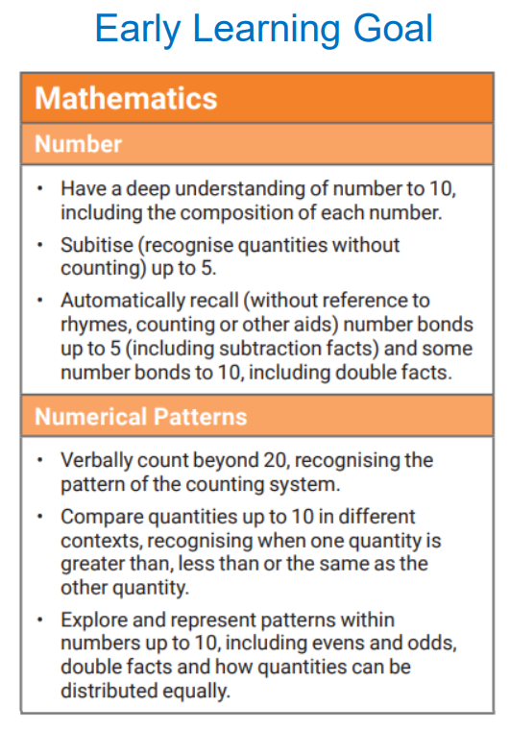
The Early Years Foundation Stage Curriculum

Slide 4
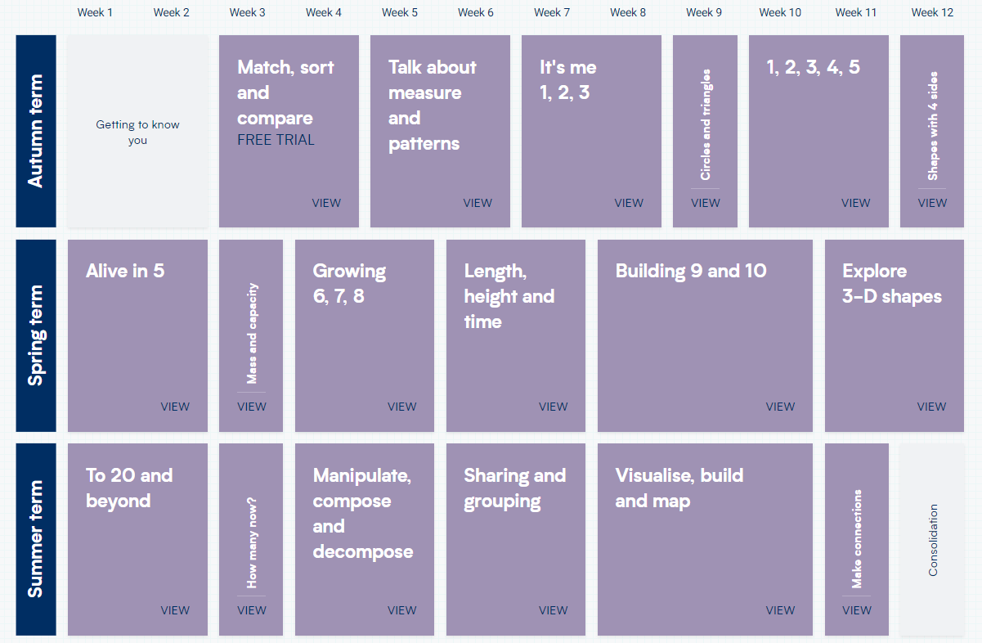
At Lime Wood Primary we use White Rose Maths scheme of work
For each year group, the scheme of learning includes an overview of the maths that your child should be learning at any point in the year.
Each year is split into three terms (autumn, spring and summer), and each term comprises individual blocks of learning about a particular topic.

Slide 5
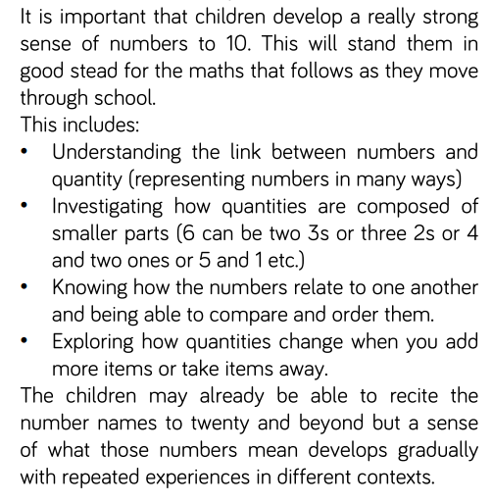
Why is there such a big focus
on the early numbers?

Slide 6
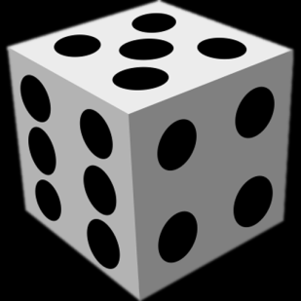
Subitising
In order for children to calculate successfully further up in the school, children need to be able to ‘subitise’ well.
This means they need to be able to recognise how many spots there are on dice, dominoes and Numicon etc instantly without counting them.
Eventually, the children will imagine these images in their head, helping them to calculate.
Subitising helps children to see, solve, and manipulate numbers in their head.

Slide 7
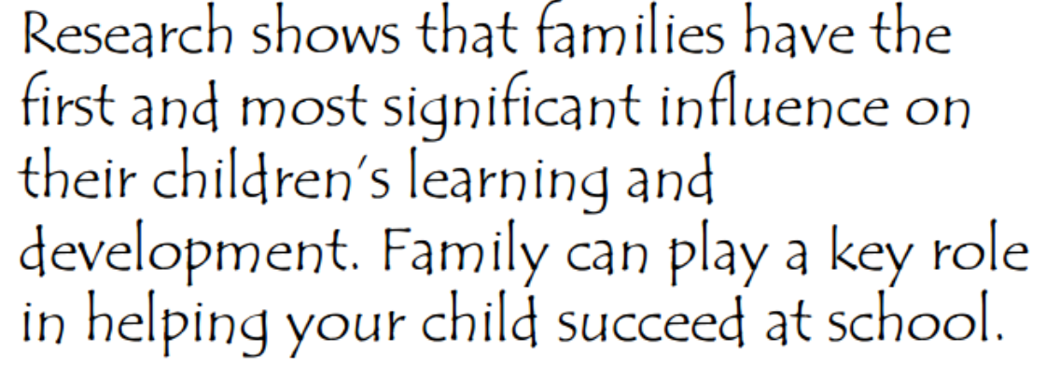
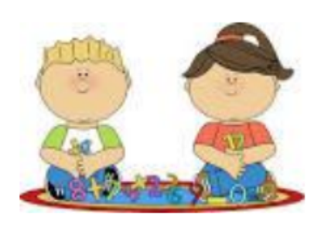
How can you help your child?
Positive attitudes make a difference!
Remember you are a role model.

Slide 8
Children need lots of experiences in making, counting, drawing and talking about numbers. Make connections for your child by explaining how numbers and counting are a part of everyday life.
Here are some practical things you can do:

Slide 9
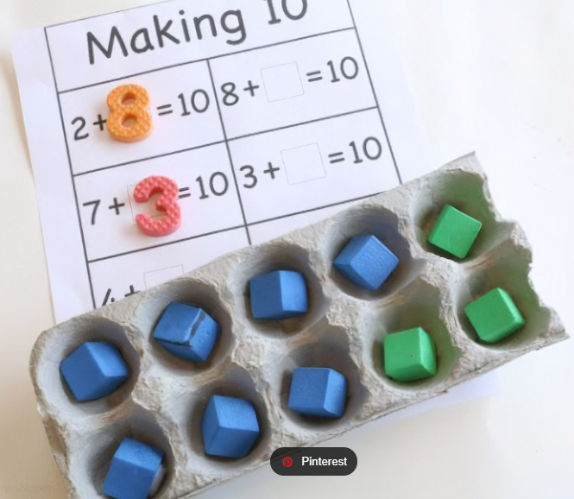
Counting
Counting – in everyday conversation, in play, steps, brushing teeth, toys in the bath, tidying toys
Wherever possible encourage your child to touch and move the things they are counting
Subitising – with teddies, spoons, socks – This is REALLY IMPORTANT!
Ordering numbers – flashcards, post it notes, lining up toys
Number bonds (pairs of numbers which add up to a certain number, e.g. 4 and 1, 3 and 2
are number bonds for 5)
– in the car, with teddies/toys
Addition and subtraction – include it in everyday conversation, cooking

Slide 10
Number formation
• Model number writing and reading in different ways: Lists, tracing, birthday cards, buses, front doors, recipes, in books, phones
• Number hunts
• Write in sand, with your finger on the carpet, paint, make numbers with play dough, on a whiteboard, on paper, post it notes, on a tablet

Slide 11
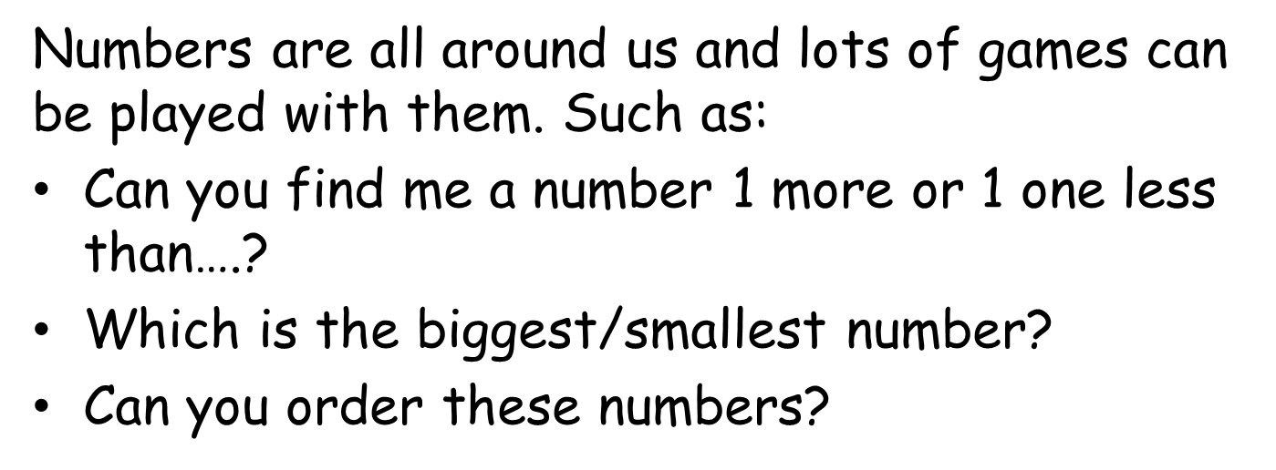
Number Games

Slide 12
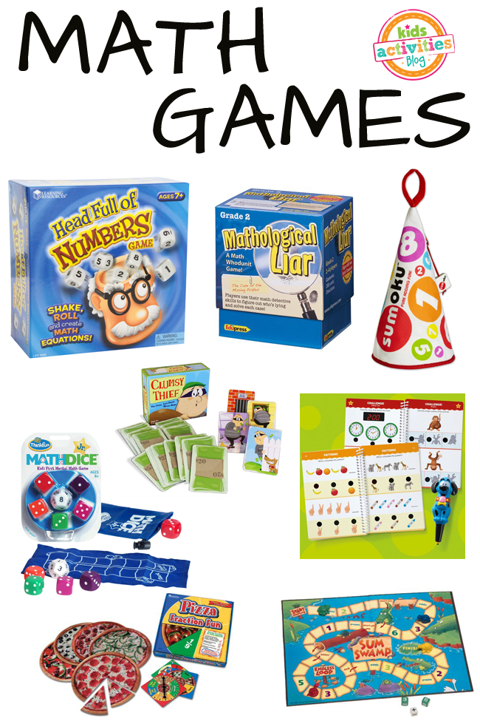
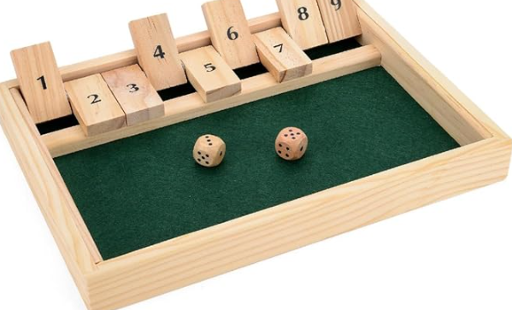
Games
• Snakes and ladders
• Board games
• Card games – snap, pairs
• Number hunts
• Hide and seek
• Bingo
Shut the Box
• Link it to fine motor activities

Slide 13
Shape and Measure
2D and 3D shapes – in everyday conversation, shape hunts, shape pictures
• Patterns – ordering objects and toys, clapping/body percussion
• Weight, length, capacity, time – language focus whilst cooking, in the bath, in the sandpit, pouring drinks, talking about routines

Slide 14
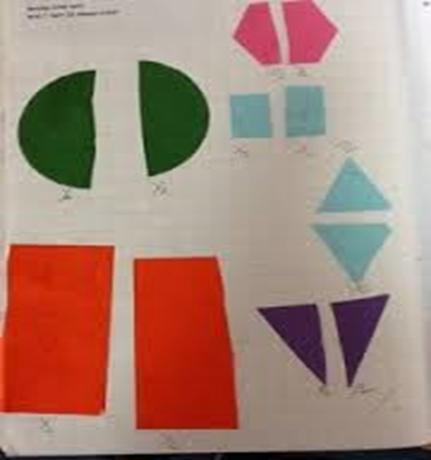
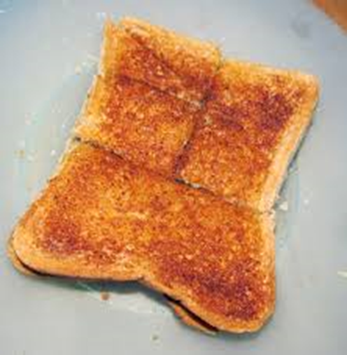
Relating maths to ‘real life’
Would you like 2 pieces of toast?
Can you cut it in half?
How many pieces?

Slide 15
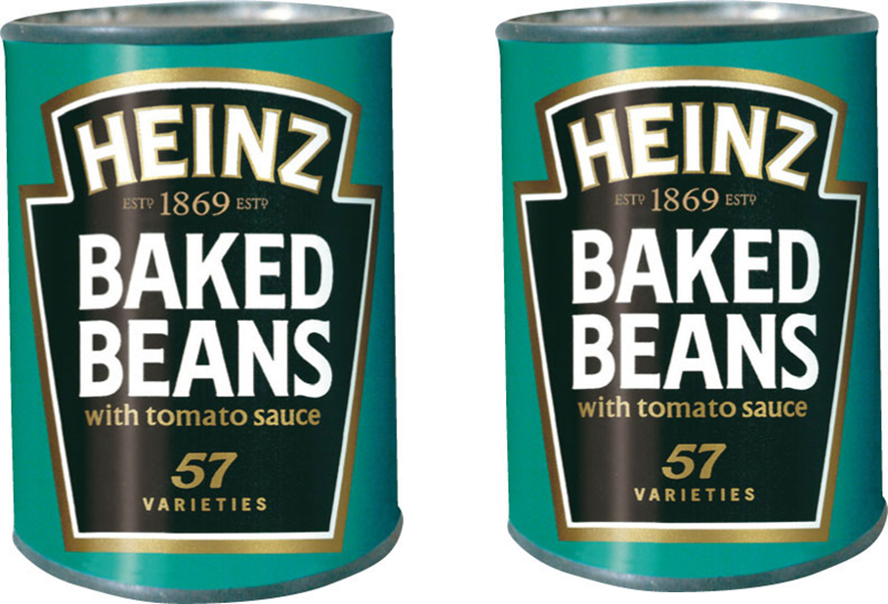
Matching the items on the list to the things on the shelves. Can you find 2 tins of beans?
Can you find 3 big apples?

Slide 16
Why do we sing songs?
Children learn through repetition
Reciting numbers is the first step to counting
They can develop understanding cardinal value as they use their fingers to represent the number they are singing
A few examples of songs we sing in class –
Supports addition – 1 Man went to Mow
Supports subtraction - 5 currant buns, 5 little speckled frogs
Supports reciting numbers – zero superhero, One, Two, Three, Four, Five, Once I Caught a Fish Alive

Slide 17
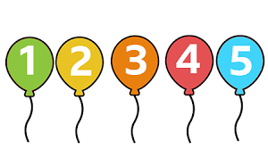
Some children are already confident with numbers to 5. How can I ensure they are being challenged?
Provide opportunities for your child to apply their understanding to reason and problem solve. Can they work out how many items are hidden if they know there are 5 altogether? Encourage them to invent their own games and use mathematical jottings to record and compare their scores.

Slide 18
A Good Mathematician is Someone Who…

Slide 20
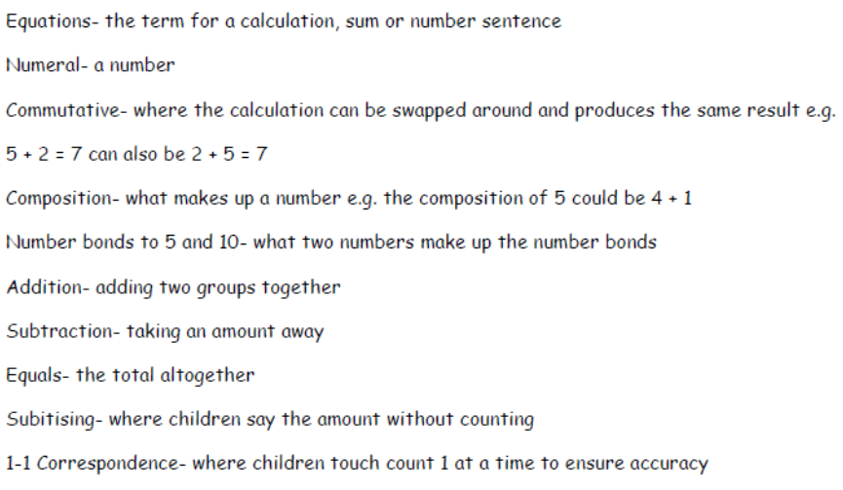

Slide 21
The activities discussed are just a few ideas you could use to help your child understand maths and problem solving.
Most of all have fun!
Please feel free to ask any questions.
Some useful websites:
BBC iPlayer – Numberblocks (episodes)
www.bbc.co.uk/cbeebies/shows/numberblocks (numberblocks games)
www.topmarks.co.uk
www.ictgames.co.uk
http://tinyurl.com/567pnyct (White Rose Maths Home Learning)
Set up YouTube Kids You can search for a wide range of videos on number bonds, shapes, maths songs, counting, Number Jacks etc.

