Slide 1
Wednesday 17th April 2024
Parent Workshop –
Preparing for year 1

Slide 2
Phonics is…
making connections between the sounds of our spoken words and the letters that are used to write them down.

Slide 3
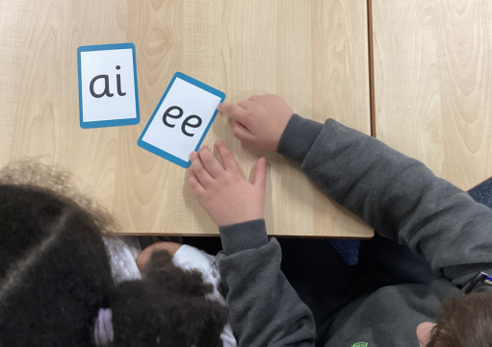
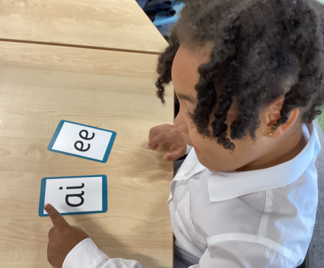
Terminology Recap
Phoneme
Grapheme
Blend
Segment
Digraph
Trigraph
Split digraph

Slide 4
This term we are teaching phase 4
Last term we taught your child to blend and read words with Phase 3 graphemes.
Some children are continuing to recap Phase 3:
the vowel digraphs and trigraphs
to read words containing the Phase 3 digraphs and trigraphs
to read longer words (‘chunking’).
This term we are teaching Phase 4. This phase consolidates all that the children have learnt so far. Children are expected to read more words by sight and blend in their heads.

Slide 5
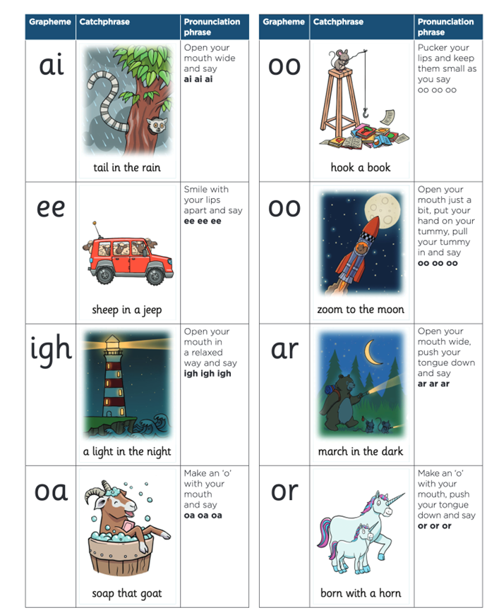
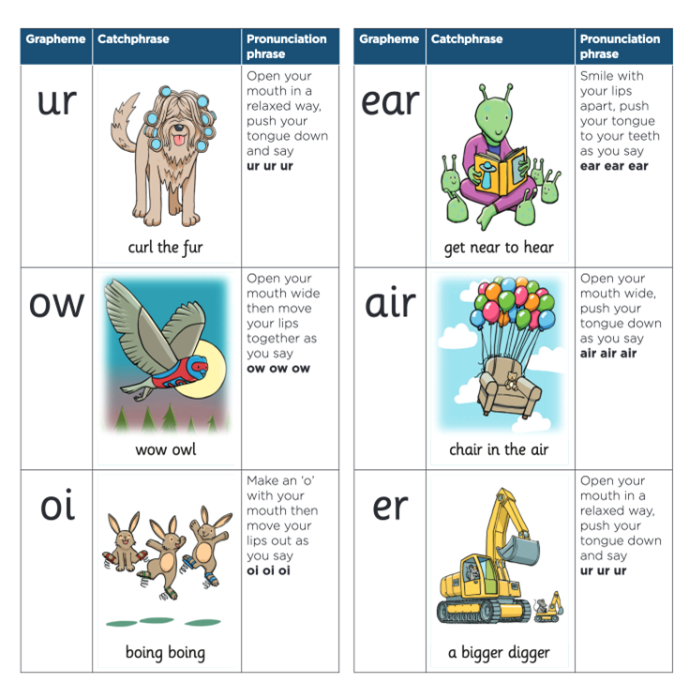
A reminder of the
Phase 3 vowel digraphs and trigraphs

Slide 6
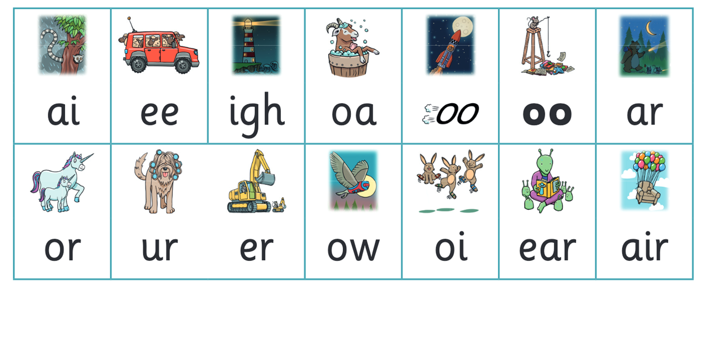
Let’s say the sounds together

Slide 7
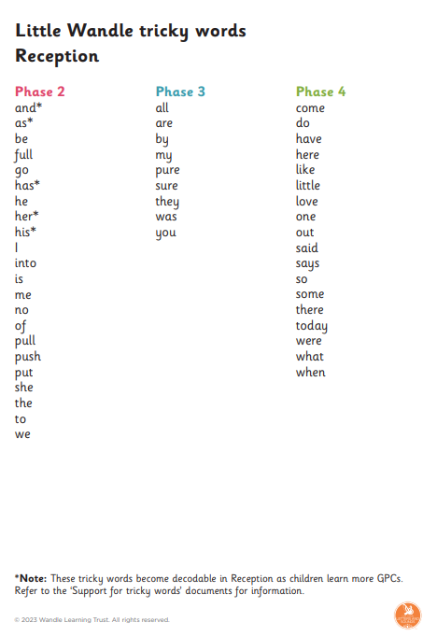
Tricky words
Tricky words continue into year one, so it is important for children to securely read and begin to write these words.

Slide 8
Year One Phonics
In year 1 your children will be taught Phase 5. They will learn new graphemes and alternative pronunciations for these graphemes.
Vowel digraphs: wh, ph, ay, ou, ie, ea, oy, ir, ue, aw, ew, oe, au
Split digraphs: a_e, e_e, i_e, o_e, u_e
Little Wandle Letters and Sounds Phase 5 pronunciation video - https://www.littlewandlelettersandsounds.org.uk/resources/for-parents/
Add grow code picture – new slide

Slide 9
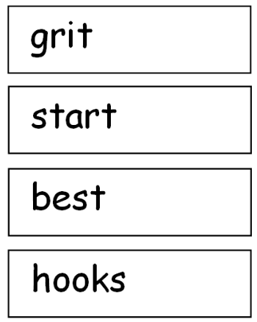
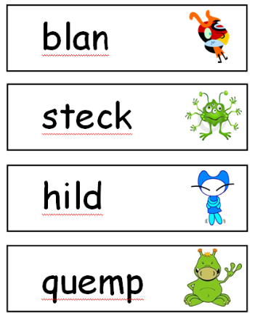
Year One Phonics Screening Test
The Year 1 Phonics Test
Focuses on your child reading real and
rubbish / alien words by sounding out and blending
Example – fuel children said fool, bowl children said bowel.

Slide 10
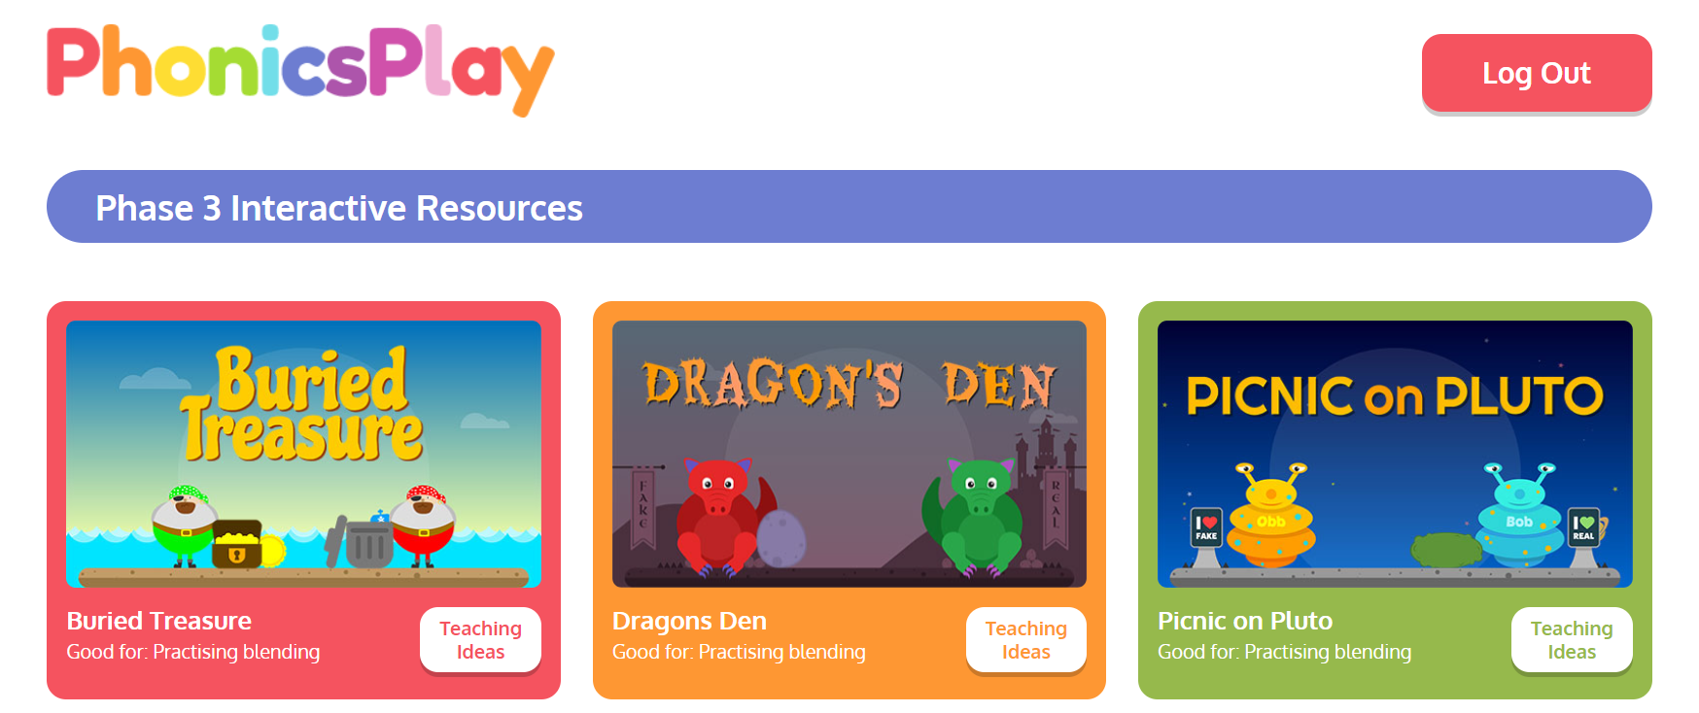
Recommended Resource
A lovely online resource to support children’s blending and identifying real and rubbish words.
https://www.phonicsplay.co.uk/

Slide 11
The importance of a strong foundation

