Slide 1


Safer Internet Day 2026
Talking Positively About the Digital World

Slide 2
We know there is a lot of negative media about screens, the internet, and now AI
Many of those concerns are understandable
But how we talk about the digital world really matters for our children

Slide 3
Today is not about blame, fear, or “perfect parenting”
It’s about building trust, curiosity, and open conversations
Especially with very young children, relationships come first

Slide 4

“Our children are growing up in a digital world in the same way we grew up in a physical one. They need guides, not warnings shouted from the sidelines.”

Slide 5
If children only hear adults talk negatively about the internet, screens, or AI, they learn one thing very quickly: this is not something to talk about
“Mum/Dad hates this stuff”
“I’ll get in trouble”
“I shouldn’t say anything if something worries me”

Slide 6
Silence doesn’t come from lack of rules. Silence comes from fear of adult reactions.
Children don’t separate “good” and “bad” online experiences in the way adults do
They just know whether something feels safe to talk about

Slide 7
The power of positive, careful language
This doesn’t mean
Saying everything online is good
Ignoring risks
Letting children do whatever they want
It does mean
Talking calmly
Being curious instead of critical
Separating behaviour from blame

Slide 8
Small language shifts that matter
Instead of: “That’s dangerous”
Try: “Let’s have a look at that together”
Instead of: “You shouldn’t be on that”
Try: “Tell me what you like about it”

Slide 9
Showing an active interest in your child’s online life
Sit with them when they use a device
Ask them to show you what they’re doing
Let them be the expert sometimes

Slide 10
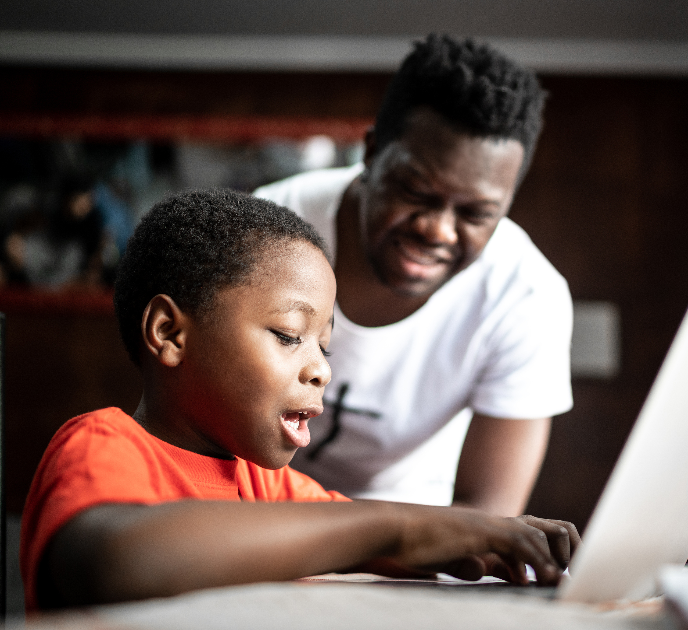
“What’s happening on the screen?”
“Who is that character?”
“How does that game work?”
“What do you like about this?”

Slide 11
Children learn that talking about the online world is normal
They practise explaining and reflecting
They see adults as partners, not police

Slide 12
Talking openly about how you use the internet and AI
Children learn from modelling
They notice how we use phones, search engines, and apps
They notice our tone when we talk about technology
Share your thinking out loud
“I’m looking this up because I’m not sure”
“This helps me find an answer”
“Sometimes the internet gets things wrong, so I check”

Slide 13
About AI
Keep it simple and honest
“This is a tool that can help, but it doesn’t always get things right”
“It’s made by people, and people make mistakes”

Slide 14
A Powerful Habit Let your child see you wondering, questioning, and checking
“Is that real or pretend?”
“How do we know if that’s true?”
“What could we do if something pops up that we don’t like?”

Slide 15
Why this matters
It builds critical thinking early
It normalises uncertainty
It teaches children they don’t need all the answers on their own

Slide 16
What children need to hear
“You won’t be in trouble”
“I’m glad you told me”
“We can sort this together”

Slide 17
Children are far more likely to speak up if:
Adults stay calm
The first response is listening
Problems are treated as shared challenges

Slide 18

“Your reaction matters more than the problem itself.”

Slide 19
The digital world isn’t going away
Our children don’t need fear
They need connection, curiosity, and calm adults

Slide 20
Speak positively and carefully about the internet and AI
Show interest, not judgement
Be open and honest
Ask questions together

Slide 21

“When children know they can talk to us about the digital world, they are safer in it.”

Slide 22
Safer Internet Day 2026
Talking Positively About the Digital World
Thank you for listening

