Slide 1
Wednesday 22nd November 2023
Parent Reading Workshop

Slide 2
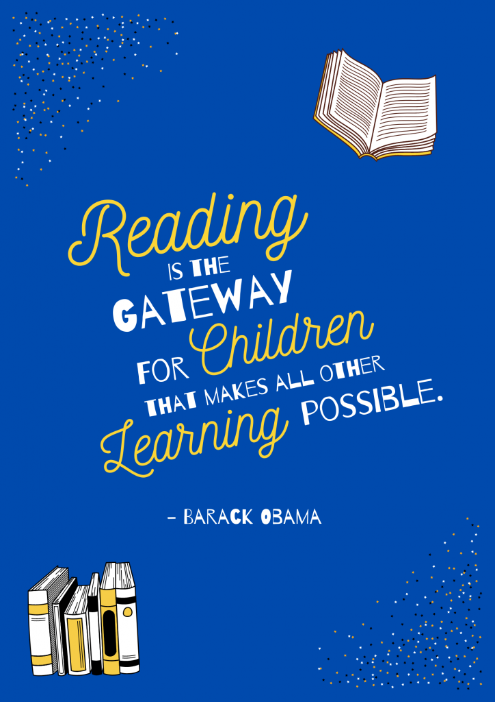
Parent Reading Workshop

Slide 3
At Lime Wood Primary School, we value reading as an essential life skill that empowers children to reach their full potential.
We have high expectations of our children as readers and our aims are:
• to teach every child to become a fluent and confident reader
• to give children the reading skills necessary to enable their learning in all subjects
• that each child grows to enjoy reading, in order that they become lifelong readers

Slide 4
Parent Reading Workshop
What are the benefits of early reading in the EYFS?
Here are some examples of why we value reading –
Developing self-regulation skills.
Developing executive function skills.
Development of personal, social and emotional skills.
Expands vocabulary.
Listen and respond to others’ opinions.
Recognising differences in others.
Boosts confidence and self-esteem.
Builds ideas for imaginative play.
Gives awareness of sentence structure.
Sparks curiosity about the world they live in.
Develops life-long learning skills and interests.
Secures relationships with others.

Slide 5
Parent Reading Workshop
For your child to reach their full potential it’s important we work together to support your child to become an enthusiastic and fluent reader.
Plan reading into every day. Protect time every day to listen and support your child read their phonics book.
Please date and sign the yellow book each time you listen to your child read their (marked in yellow book as P)phonics book.

Slide 6
Parent Reading Workshop
Phonic reading books
Children begin with wordless books. These are the foundation to understanding books, developing great language skills and teach children the layout of books and how to handle books. Can your child tell you what is going on in the book using full clear sentences?
Once children have secure knowledge of a number of GPC’s (Grapheme Phoneme Correspondences) and are confidently blending, they will be ready to read books. Books correspond to the letters and sounds children have learnt in class.

Slide 7
Parent Reading Workshop
Phonic reading books
A glimpse at a wordless book reading group
Don’t forget to remind your child to use their ‘phonic finger’ to point to the graphemes as they say the phonemes

Slide 8
Parent Reading Workshop
Reading for pleasure
With the help of parents, children can learn how to read and can practise reading until they can read for their own
enjoyment. Then they will have a whole world of information and knowledge at their fingertips!
Reading can be a family activity. Spending time with word games, stories, and books will help your child to:
• gather information and learn about the world
• learn how stories and books work – that they have beginnings, endings, characters, and themes
• build a rich vocabulary by reading and talking about new words
• learn how to listen and how to think
• learn the sounds of language and language patterns
• fall in love with books

Slide 9
Parent Reading Workshop
Activities are set up for you to explore.
Ipads – phonics play, topmarks – balloon phonics
Magnetic letters spelling games – can you make the words/sentence?
Tricky word search - how many tricky words can you find in the book?

Slide 10
Parent Phonics Workshop
What can you do to support your child?
- Go to the Little Wandle website to access videos and guidance for parents.
Share books with your children for pleasure.
Check on our website for documents to support reading and phonics.
Encourage your child to use their phonic knowledge and blending skills daily.
Help them spot tricky words when out and about.
Reread books to develop fluency.
Provide lots of encouragement and praise.
Play ‘I Spy’ with letter names, sounds and tricky words.
Write tricky words on flashcards and stick them around the house. How many can they read in a set amount of time?

Slide 11
Parent Phonics Workshop
Thank you for listening.
Any questions?

