Slide 1


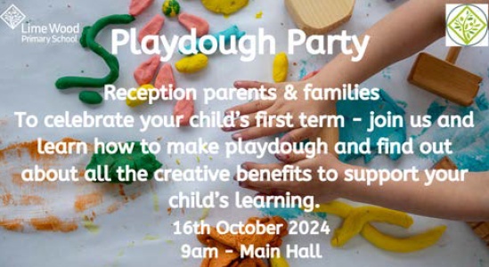
Ignite the spark, reveal the champion
Welcome!
Notes:
Welcome CI and over to AH

Slide 2
Creative learning in the EYFS curriculum
Notes:
ALL

Slide 3
Why is playdough a great learning activity?
Communication and Language: explore new vocabulary, encourage social conversation, promote imaginative play, explore instructional language
Understanding of the World: exploring and investigating materials/ textures using all the senses
Maths: investigating capacity / weighing/ measuring/ counting (during the cooking process), counting, ordering
Physical Development: fine motor development through: pinching/ squeezing/ pushing/ pincer grip/ poking/ squishing/ rolling/ rolling/ digging
Expressive Arts & Design : making dough represent other objects/ sculptures/ role-play/ imaginative play
Literacy: role-play language/ new vocabulary e.g. herb names
Personal and Social Emotional Development: working independently/ sustained involvement at play, sharing with others.
Notes:
ALL

Slide 4

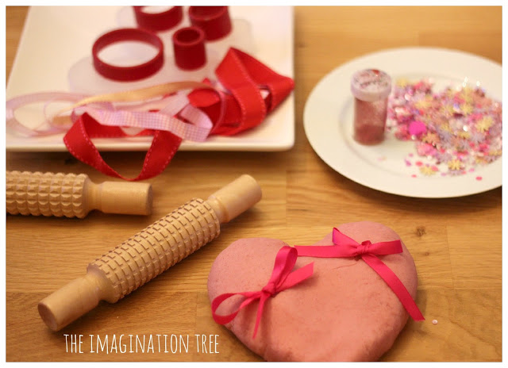
Jelly Playdough
Follow the basic play dough recipe, just add jelly powder to hot water instead.
Wonderfully scented. You can also add glitter.
Notes:
ALL

Slide 5
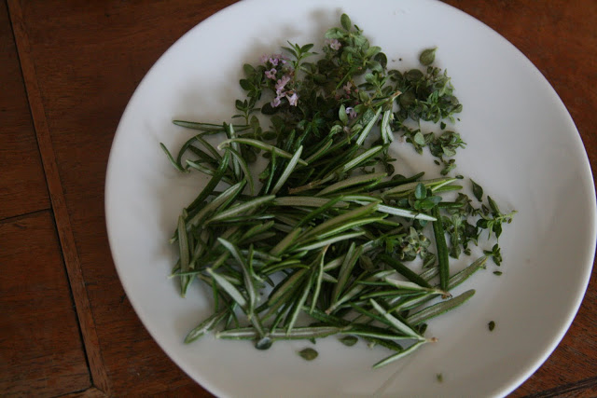
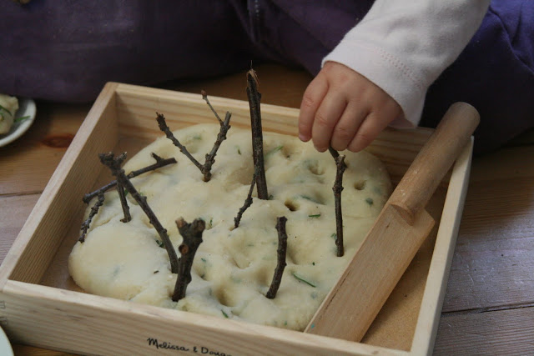
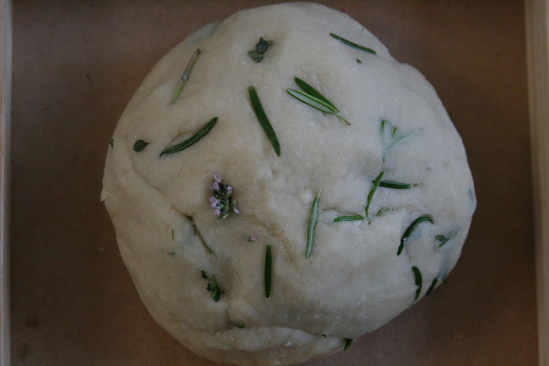
Natural Playdough
Follow basic play dough recipe, and add natural objects, thyme, rosemary, lemon juice, aromatherapy oils. You could add sticks and leaves too!
Notes:
ALL

Slide 6
Natural Playdough
By providing objects from nature with a wide range of textures, colours and shapes, children can have multi-sensory experiences and engage with the world around them in a whole new way.
Using a variety of natural items, why not make play dough pizzas!
All of these elements can be used to create plenty of exciting, open-ended play times: pebbles, stones, shells, grass, herbs, sticks, bark, leaves, flowers
Benefit:- Fine Motor Skill Development: great for strengthening muscle tone in little hands – squishing, squashing, rolling, flattening play dough all develop children’s muscles and encourage prewriting and other skills such as cutting with a scissors, using a tweezers, holding a pencil etc.
Notes:
ALL

Slide 7
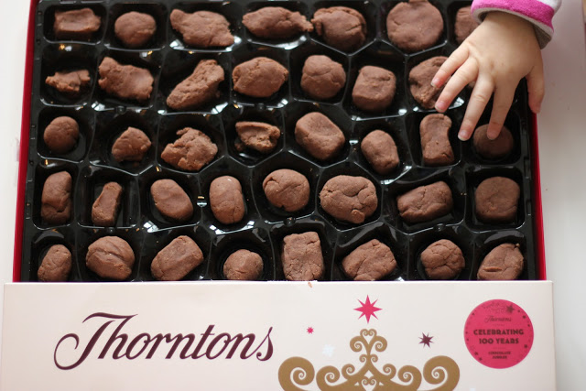
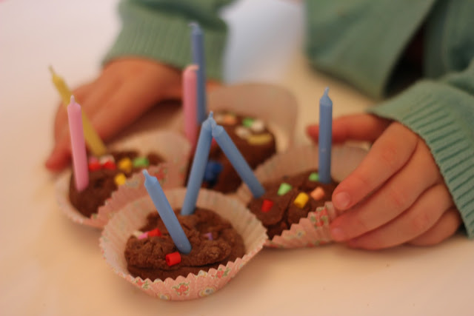
Chocolate Playdough
Follow basic play dough recipe and substitute some cocoa powder instead of flour.
Add decorations, candles, etc.. Can be a great maths activity!
Notes:
ALL

Slide 8
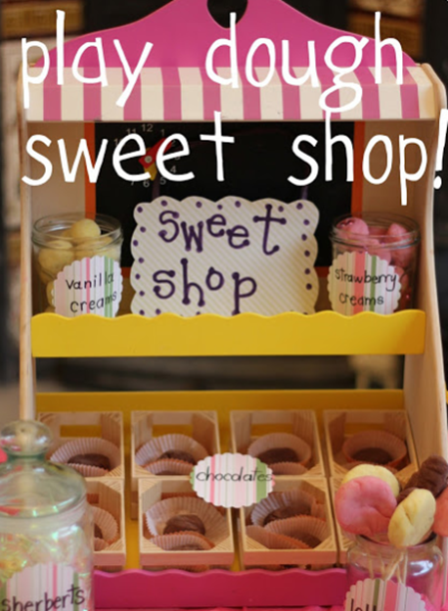
Sparkly Playdough
A jar of candles and cupcakes cases leads naturally to birthday party role-play, counting out candles and singing! It can be chocolates and sweets in a sweet shop, cakes and bread in a bakery. The list is as endless as a child’s imagination!
Benefit: - Creativity and imagination. The possibilities for play dough play are limitless – children can create all sorts of things with play dough – monsters and aliens, cupcakes, pizzas, gardens, houses, Christmas decorations. By enabling children to use a variety of items with their play dough can lead to hours of imaginative play.
Notes:
ALL

Slide 9
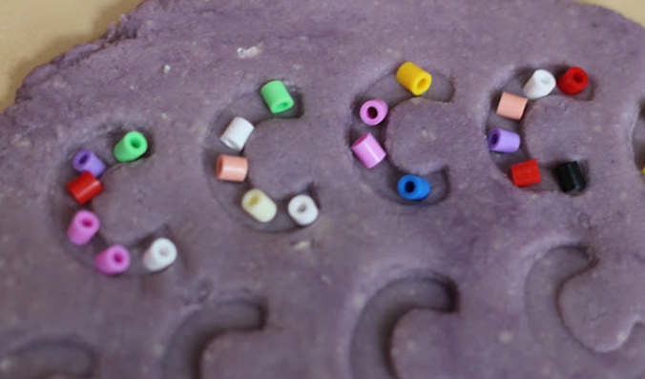
Textured Playdough
Play dough can be used as a fantastic way to practise letter and number work. You can enable children to use a variety of resources to enhance their learning: - toy creatures, straws, rolling pins, scissors, number and letter shaped cutters, beads, egg cartons, buttons, toy vehicles, match sticks, lolly sticks.
All of these elements can be used to add to play dough to create a different texture:- rice, cous cous, coriander seeds, poppy seeds, sesame seeds, sawdust, sand, pebbles, rock salt, tiny uncooked pasta, porridge oats
Benefit: - develop, practise and extend their maths and literacy learning. Children can form letters of the alphabet, spell out their own name, make numbers, form 2D and 3D shapes, compare lengths/ thicknesses/ weights, count out rolled balls to match numeral cards, match and sort by colour, shape or size and SO many more ideas too!
Notes:
ALL

Slide 10
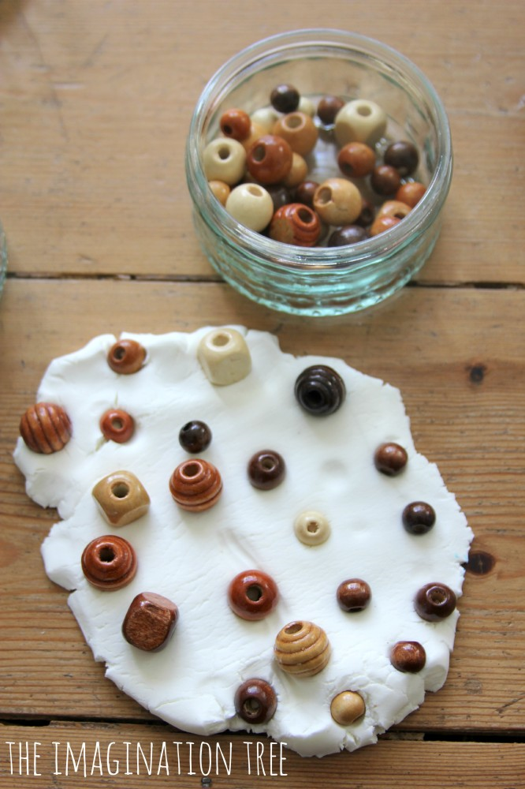
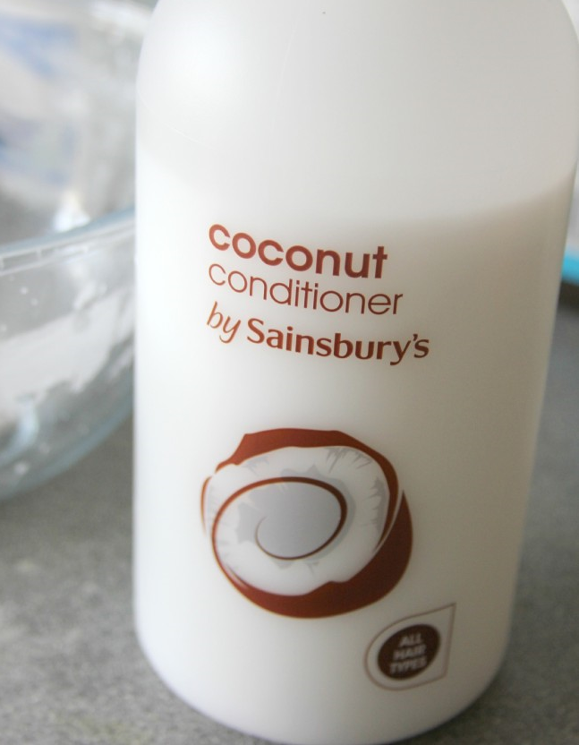
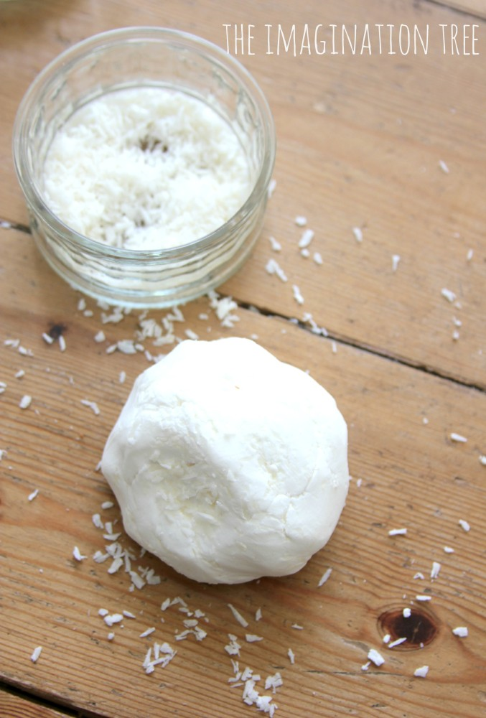
This play dough recipe only calls for corn flour and coconut conditioner!
It’s creamy texture and wonderful smell adds something different!
Creamy Coconut Playdough
Notes:
ALL

Slide 11
How to make playdough
Easy to make – all you need is 5 minutes and the best bit – no cooking!
Mix all of the ingredients together in a bowl – it’s great for making with your child/ren and will last for quite a while! You can add glitter for sparkles or even peppermint oil for a great smell!
Ingredients:
1 cup plain flour
½ cup of salt
2 tbsp of cream of tartar (optional)
1 tbsp of cooking oil
Food colouring
Glitter (optional!)
Essential oil (optional!)
1 cup of boiling water – Adults only!
Method:
Place all the ingredients in a large bowl and mix. As soon as it starts to bond together and is hard to mix, take out of the bowl and knead on a board until it takes on the look and consistency of playdough. HEAT warning – it may be hot when it comes out of the bowl so take care.
Enjoy!!
Notes:
ALL

Slide 12

Playdough Fun
We would love to hear about your adventures at home making playdough – send us some photos!
ANY QUESTIONS
Notes:
ALL

