Slide 1


Thursday 24th October 2024
Parent Workshop –
Phonics in
year 1

Slide 2

Terminology Recap
Phoneme
Grapheme
Blend
Segment
Digraph
Trigraph
Split digraph
Example - cake

Slide 3
Phonics in year 1
At the beginning of Year 1 in the first half term, the children have the opportunity to recap and consolidate what they have learnt from phase 3 and 4.
After this the children move onto Phase 5, which they work on for the rest of Year 1.
The phonic lessons follow the same format as in Reception and half termly assessments will continue.

Slide 4
Phase 5
Purpose:
To read more common exception words:
their people oh your Mr Mrs Ms ask could would should our house mouse water want any many again who whole where two school call different thought through friend work once laugh because eye because eye
To spell: said, so, have, like, some, come, were, there, little, one, do, when, what, out, oh, their, people, Mr, Mrs, called, asked

Slide 5
Phase 5
To learn that there is more than one way to spell a sound (phoneme) and that different graphemes can be used, sometimes more than one.
E.g. ou makes the same sound as ow etc
ie, i_e, i, y can all make the same sound as igh
To learn that there are different pronunciations of already known graphemes (sometimes more than one).
E.g. cow, snow pie, thief chin, Christ, chef

Slide 6
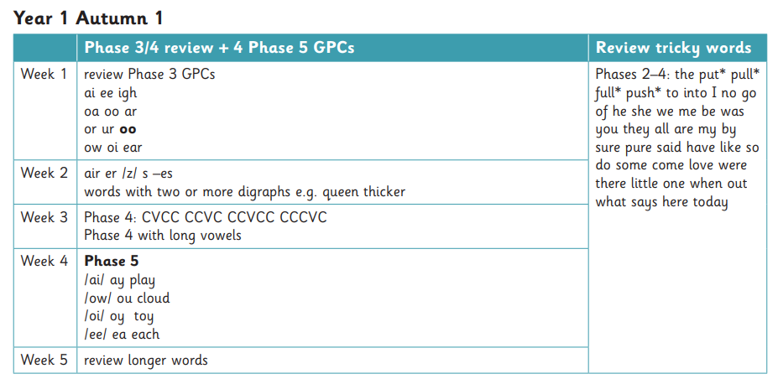
Year 1 programme progression

Slide 7
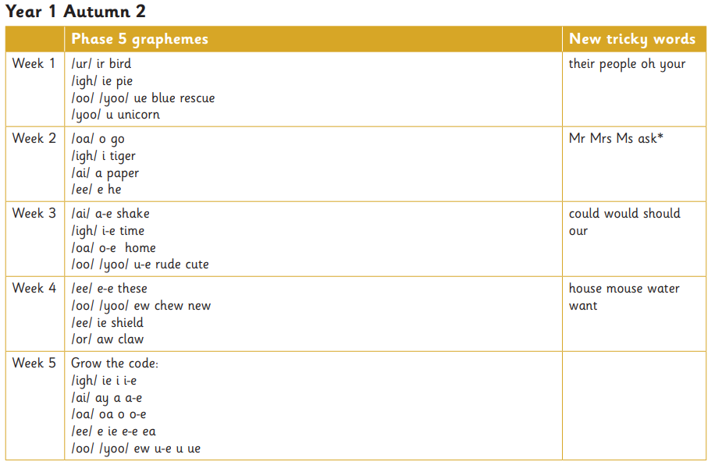
Year 1 programme progression
Further termly information is accessible on the school website

Slide 8
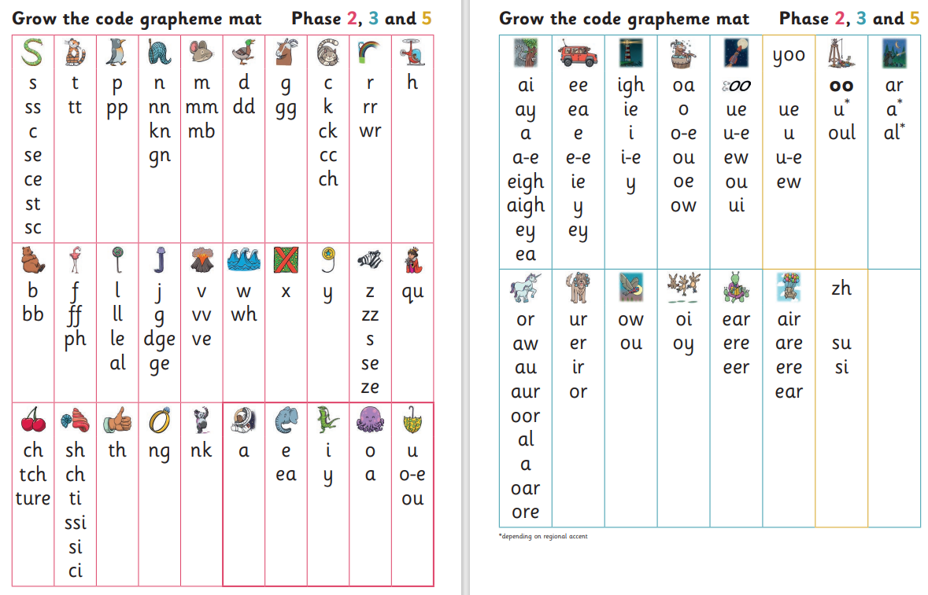
Year 1 Grow the code
By the end of Year 1 the children should be able to recognise all of these graphemes when reading and begin to use them appropriately when spelling words.

Slide 9
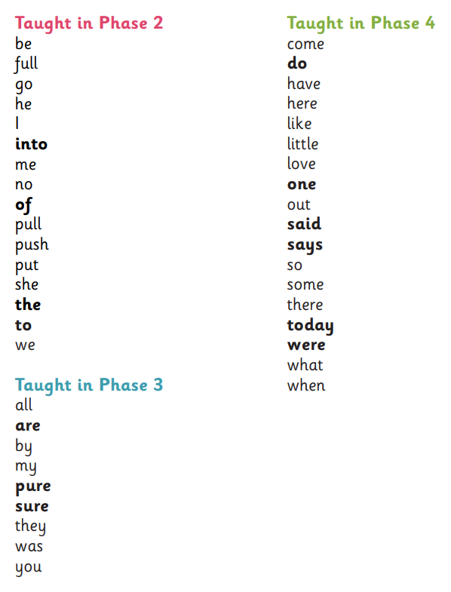
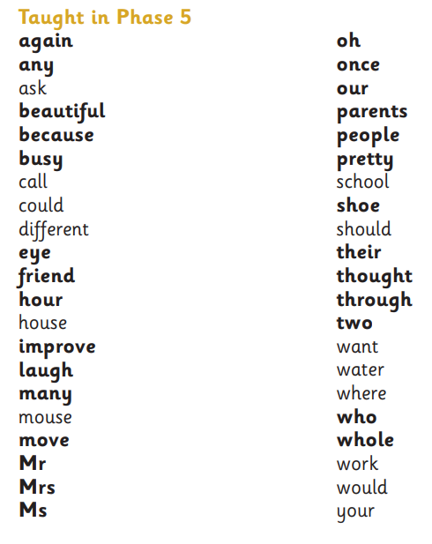
Tricky words
Tricky words continue into year one, so it is important for children to securely read and begin to write these words.

Slide 10
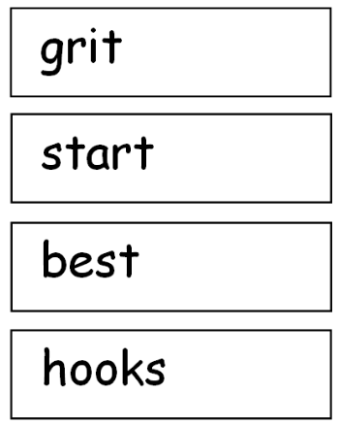
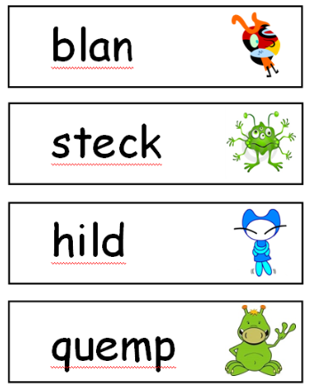
Year One Phonics Screening Test
The Year 1 Phonics Test
Focuses on your child reading real and rubbish / alien words by sounding out and blending.
Example – fuel - children said fool, bowl - children said bowel.

Slide 11
Year One Phonics Screening Test
YEAR 1 PHONICS SCREENING CHECK will be in June 2025.
Set by the government and is Statutory.
40 words to read. 20 real, 20 nonsense/alien
Words to be read by pure sounding out and blending
Those who do not achieve the desired pass mark (last year was 36)will need additional support in Year 2.

Slide 12
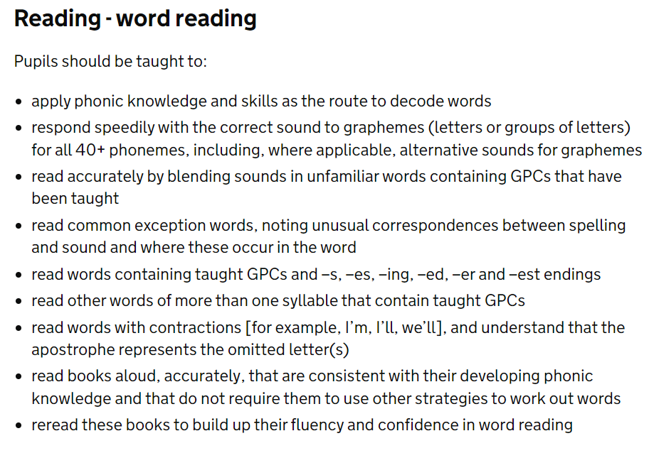
The National Curriculum –
word reading
YEAR 1

Slide 13
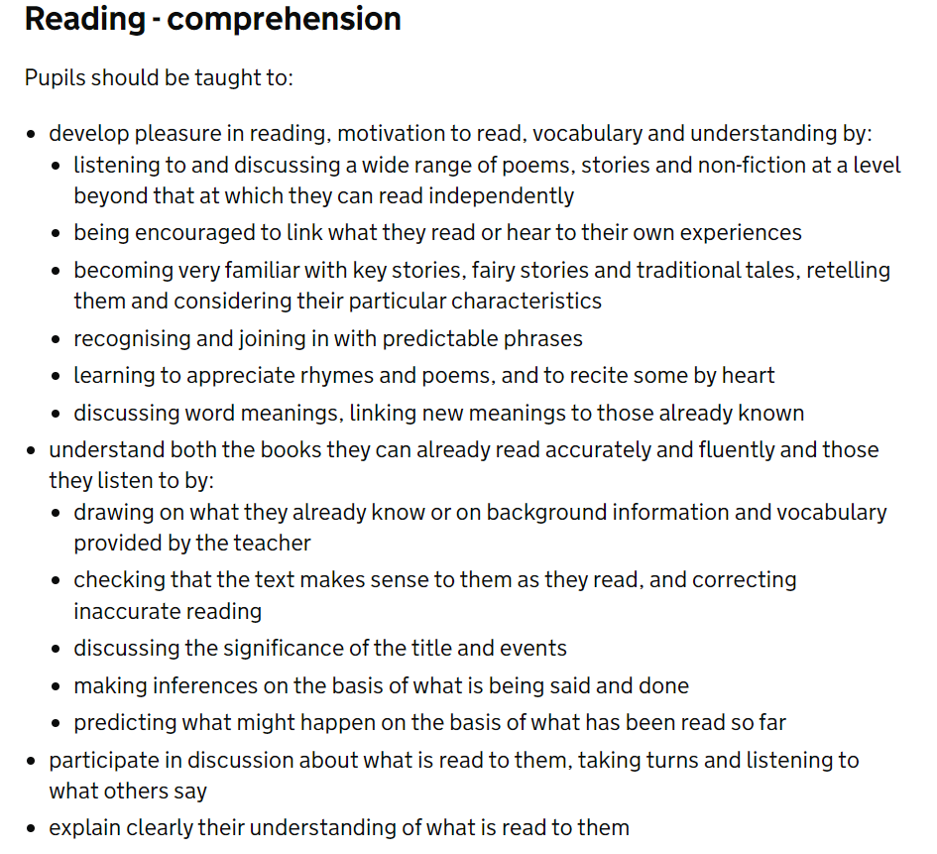
The National Curriculum –
reading comprehension
YEAR 1

Slide 14
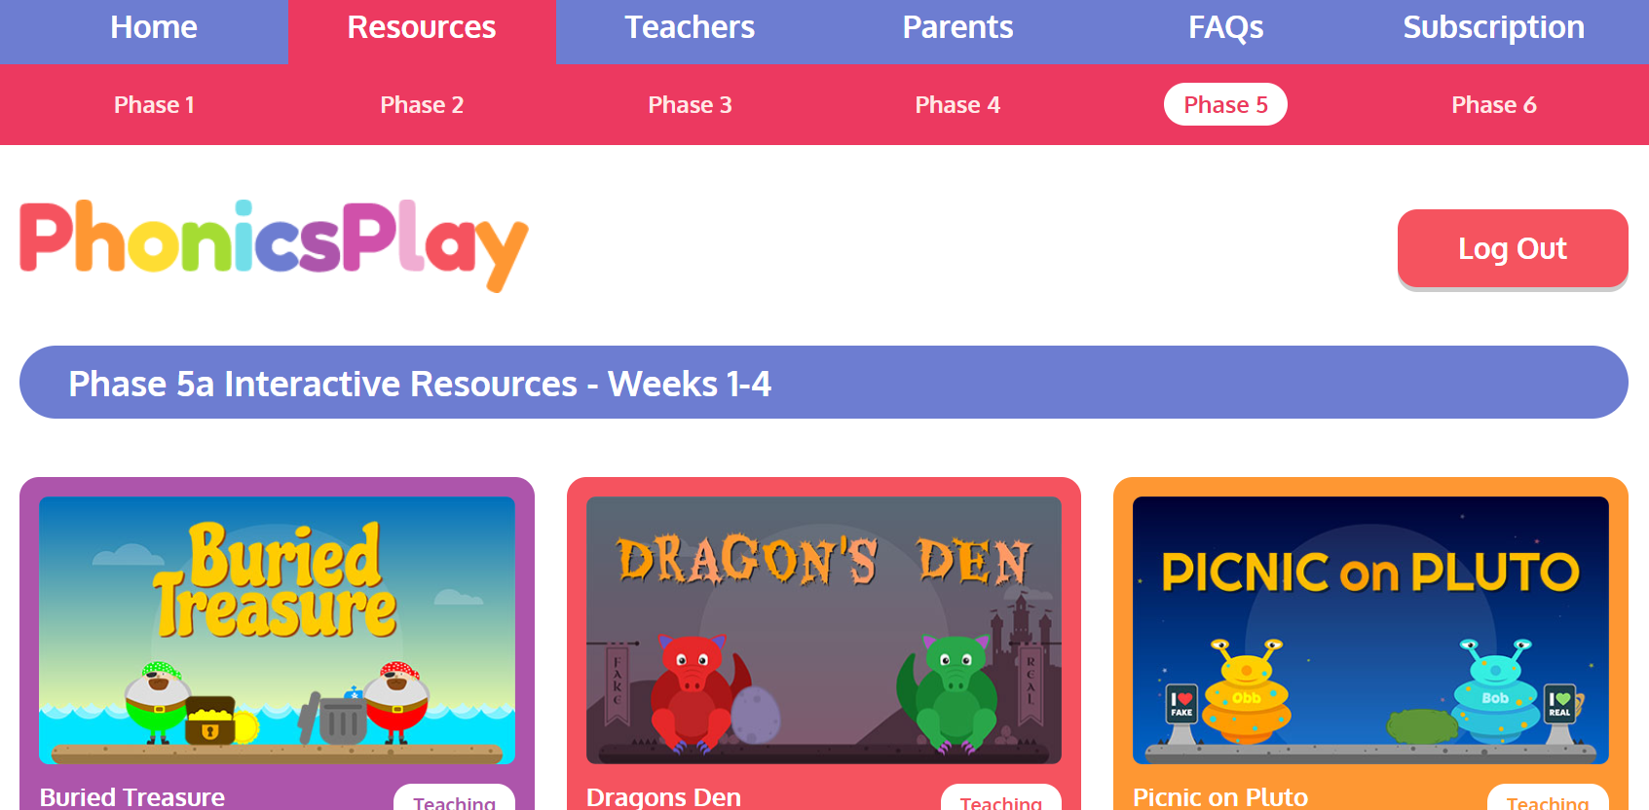
Recommended Resource
A lovely online resource to support children’s blending and identifying real and rubbish words.
https://www.phonicsplay.co.uk/

Slide 15

Any questions?
A link to the Little Wandle parent help section –
https://www.littlewandlelettersandsounds.org.uk/resources/for-parents/

Slide 16

The importance of a strong foundation

