Slide 1
Monday 27th February 2024
Parent Early Writing Workshop

Slide 2
Early writing skills…
Early writing skills help children:
understand that scribbling and drawing is an initial step to writing
connect their thoughts and ideas with written form
prepare for future learning experiences

Slide 3
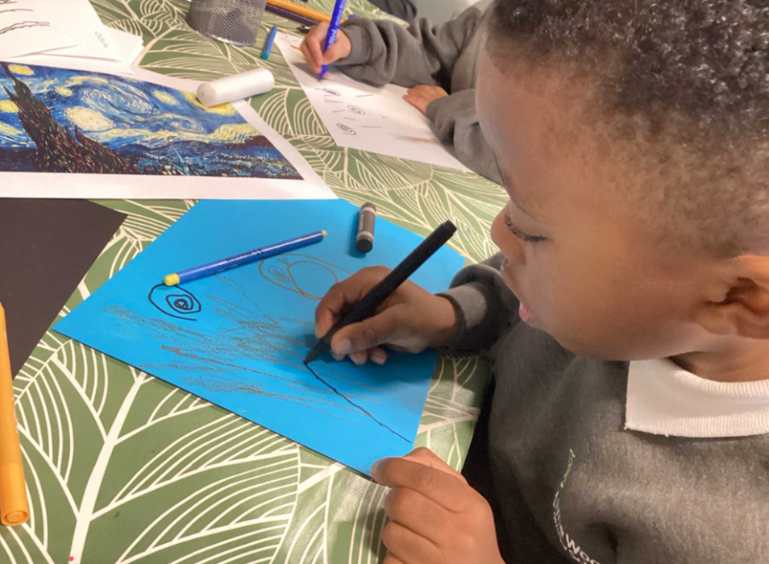
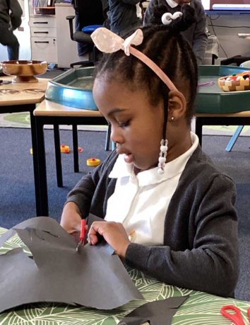
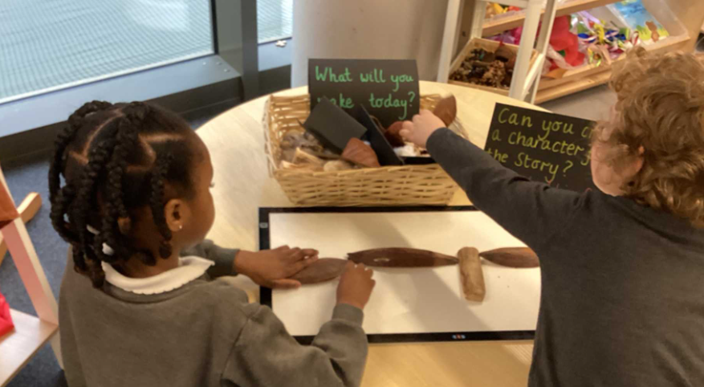
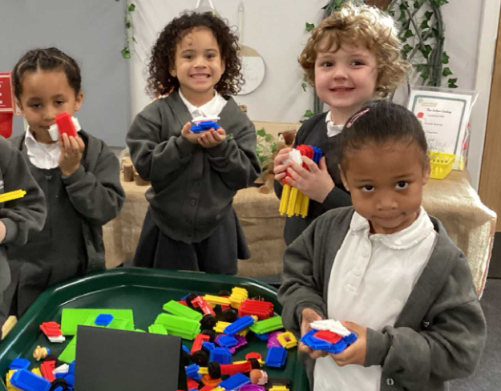
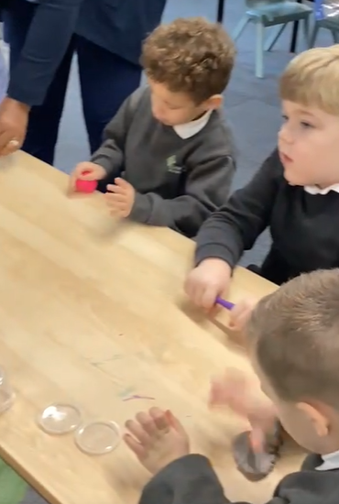
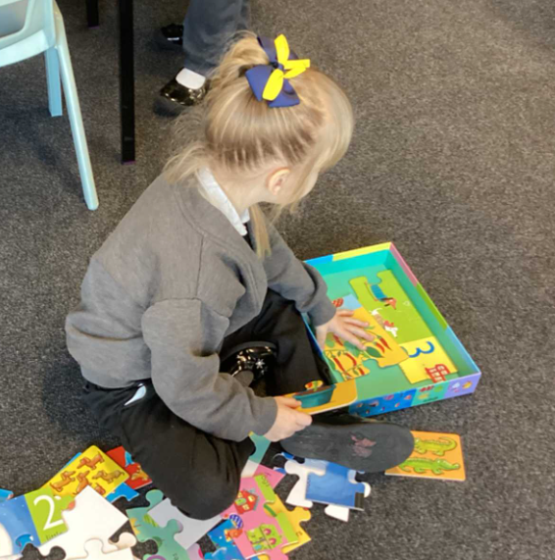
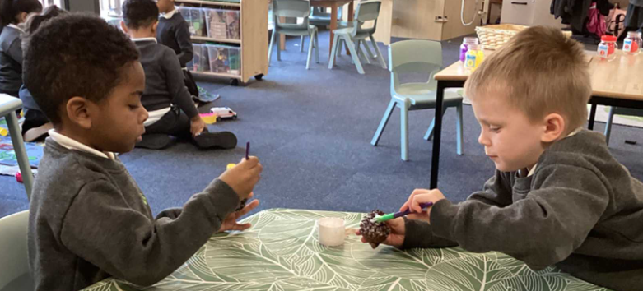
Physical development
Writing is very tricky!
Before children can hold a pencil or write, they must be physically ready. There are always lots of activities set up for children to improve their physical development.

Slide 4
Physical development
Gross Motor Skills
·climbing
· jumping
· balancing
· skipping
· batting
· swinging
· throwing
· skywriting
· writing on backs
·water/paintbrushes
· chalks outside
Fine Motor Skills
· sewing
· threading
· tap a shape
· jigsaws
· playdough
· lego/building
· drawing
· colouring
· cutting/sticking
· patterns
· painting
· letter shapes
For handwriting children need to be well co-ordinated
through their whole body, not just their hands and fingers.

Slide 5
Stages of writing development
Scribbling/Drawing: Believe it or not the first stage of writing is scribbling and drawing! Some young learners begin with random marks on the paper, and others create a drawing for their thoughts.
Letter-Like Formations: Children will begin to attempt mimicking letter formations in their writing.
Strings of Letters: At this stage children are beginning to form letters and write their name.
Letters and Spaces: Children begin to match letters to the sounds they are writing. This can be in form of labelling a picture or creating a sentence with spacing between words.
Conventional Spelling and Writing: At this stage young learners begin to incorporate conventional spelling, spacing in between words, and punctuation.

Slide 6
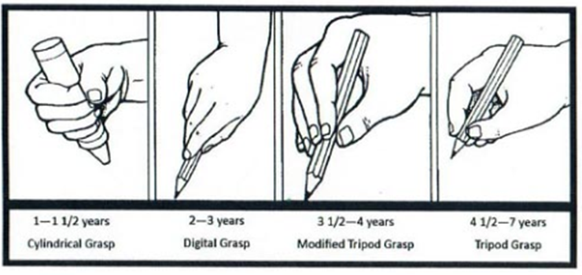
Pencil grip

Slide 7
Pencil grip

Slide 8
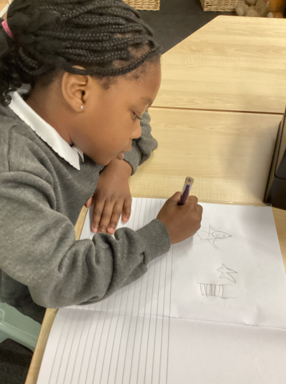
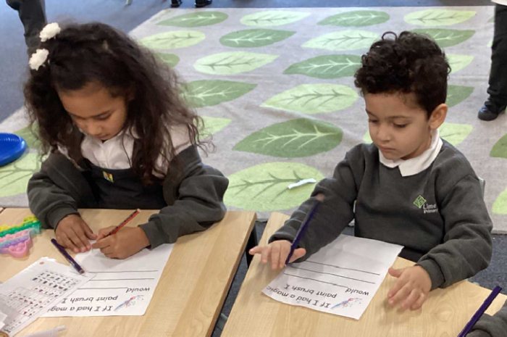
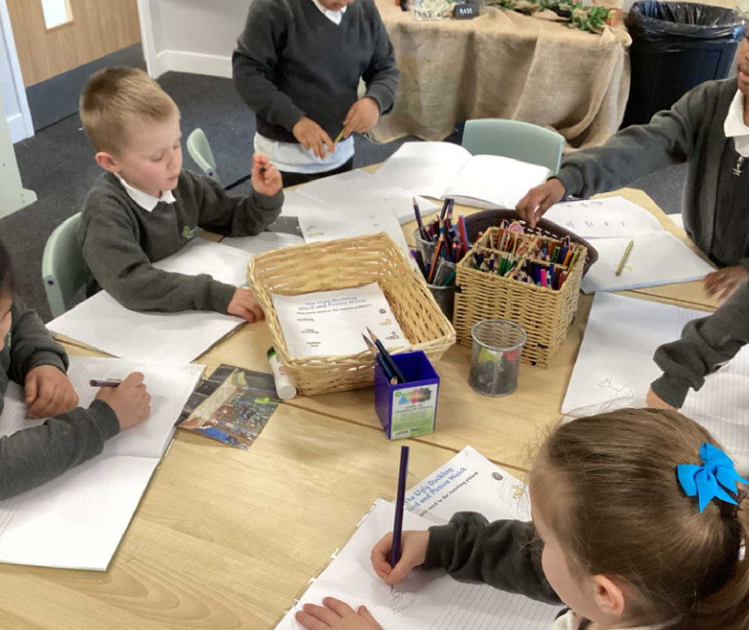
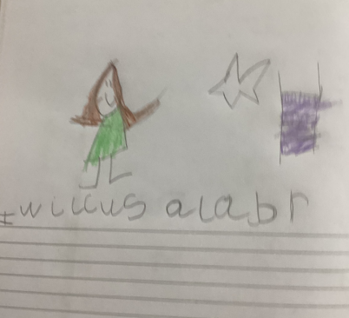
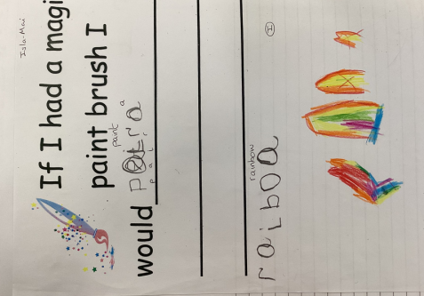
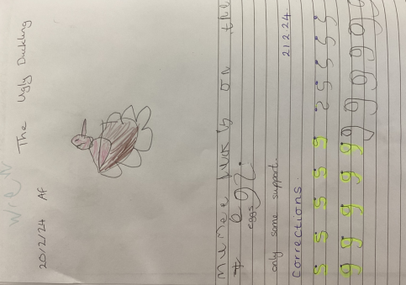
Adult focus

Slide 9
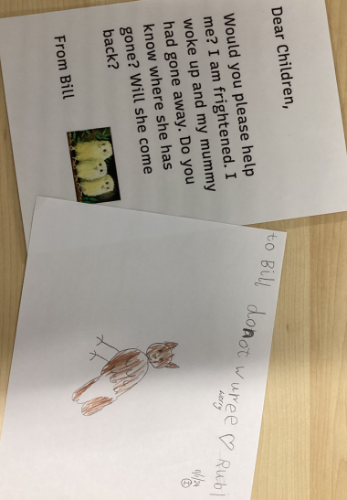
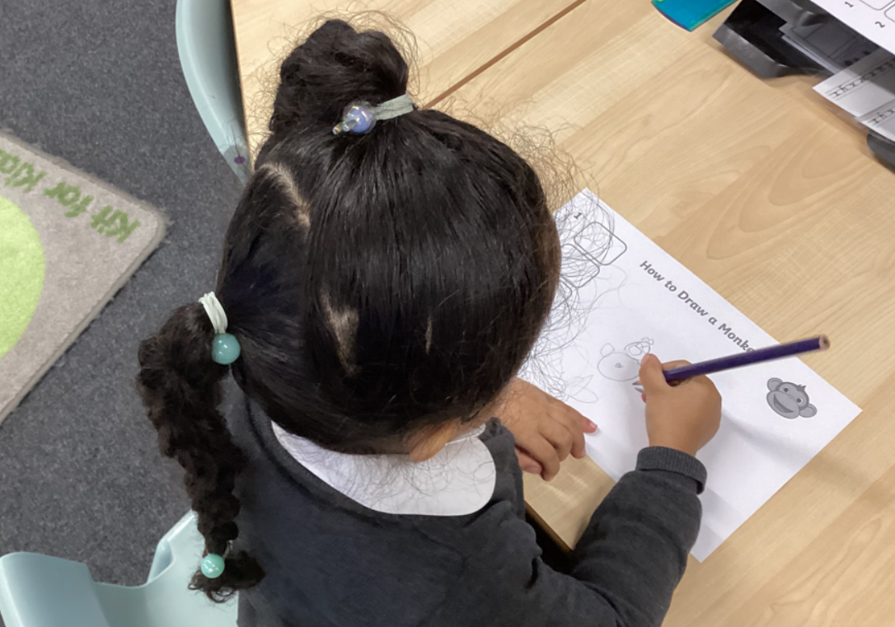
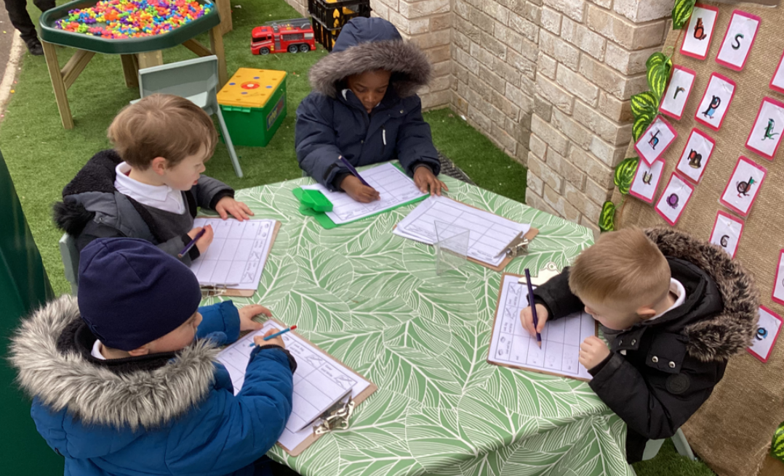
Provision
Children are encouraged to write as part of their purposeful play. They write in a variety of role play situations that match their interests and stimulate talking. They experiment with writing by making marks, personal writing symbols and conventional script. They are given lots of praise and
encouragement to have a go

Slide 10
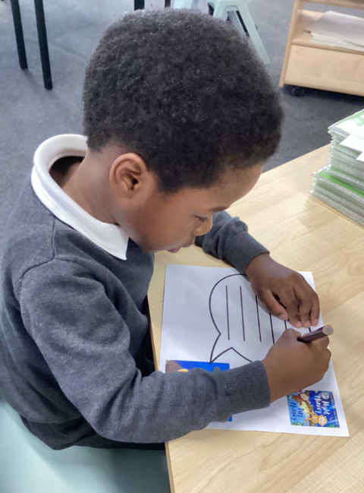
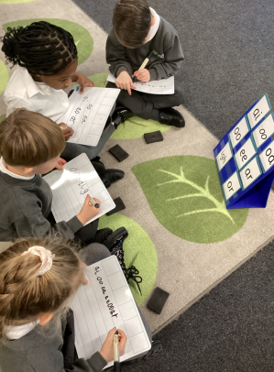
Writing
This term, your child will be taught how to spell words every day using the graphemes they have been taught so far.
They will practise writing a dictated sentence.

Slide 11
Let’s have a go at writing together
Can you write phonetically?

Slide 12
How can I help my child
Ensure your child using a good pencil grip
Model writing for a purpose and ask them to help you.
Ideas -
Shopping list
Note for a member of the family
A letter to a relative or friend
Labels for your kitchen cupboards
Instructions for how to make something such as a sandwich
A story about their favourite toy
A diary entry about their day

Slide 13
The importance of a strong foundation

