Slide 1

Ignite the spark, reveal the champion
March 2026
End of Keystage 1 Assessments

Slide 2

End of Keystage 1 Assessments
Standard Assessment Tests
SAT stands for Standard Assessment Test. These tests are designed to measure how well children have mastered the National Curriculum core subjects.
For Key Stage 1, it is up to the school if they choose to have pupils sit SATs exams or not - whereas during Key Stage 2 in Year 6, everyone takes SATs. When it comes to the tests themselves, SATs are a way of evaluating how much the children have learned so far in primary school and in particular core subjects.
The tests measure progress and while it can feel daunting for parents, it is part of every day life in school for your child to be assessed. They are not pass or fail tests!

Slide 3
End of Key Stage 1 Assessments
They are still compulsory at the end of key stage 2 – this data is reported to the Government.
SATs not only measure your child’s progress, but they're also a way for the Government to measure the school's performance and make secondary schools aware of your child’s progress.

Slide 4
How do we assess children?
How do we assess your child?
Teachers assess children everyday to help us plan their next steps.
We also assess formally three times a year in each year group. This information feeds into pupil progress meetings between teachers and senior leadership team where the progress of children is discussed and any areas to develop are flagged up. If your child is not making expected progress, then this will be discussed and any actions needed put into place. We will discuss this with you at parents evening or have an informal chat.
We call this tracking and it is based on our Teacher Assessment.
SATs are a formalised standard assessment. They take place in the summer term.

Slide 5
End of Keystage 1 Assessments
There are 4 SAT papers –
Reading,
EGPS – English Grammar, Punctuation and Spelling,
2 maths papers – arithmetic and reasoning..

Slide 6
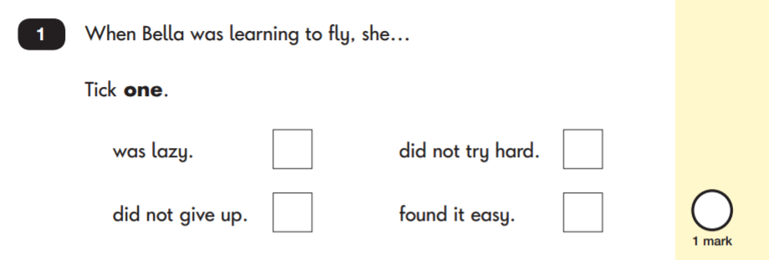
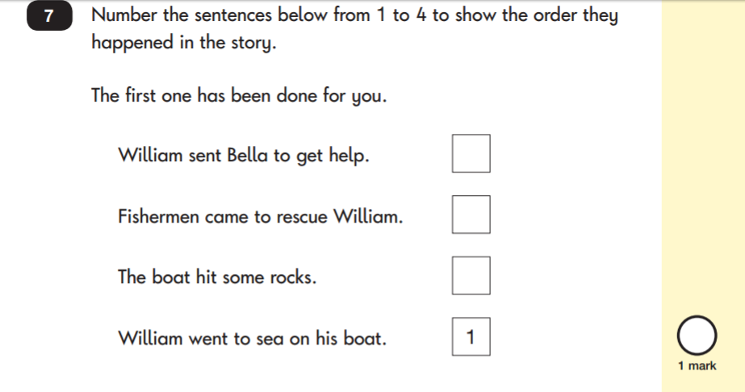
Reading question examples

Slide 7
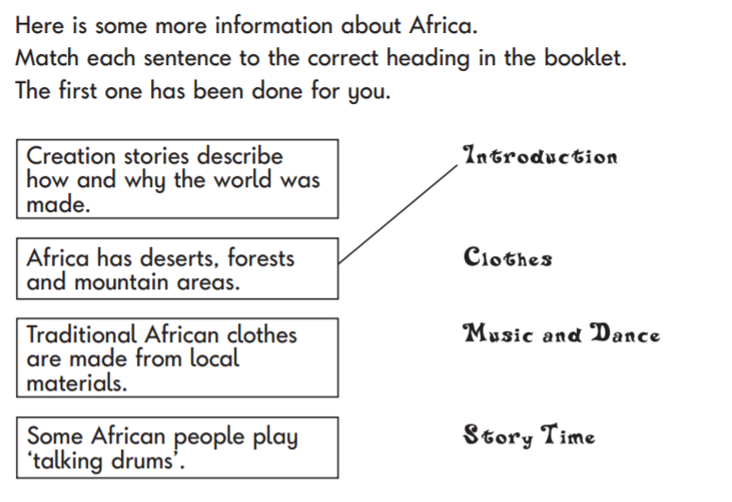
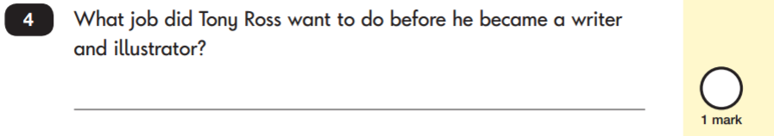
Reading question examples

Slide 8
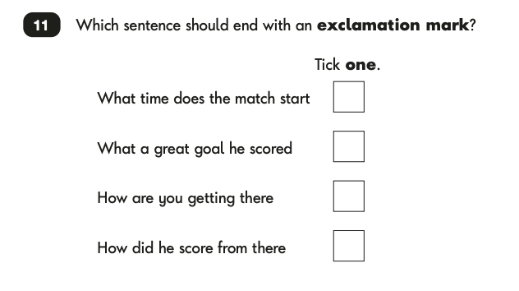
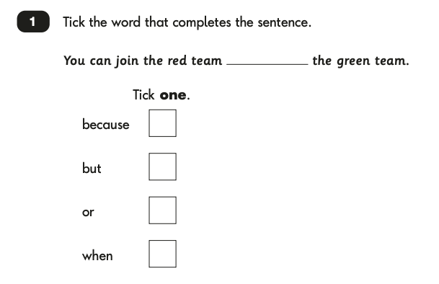
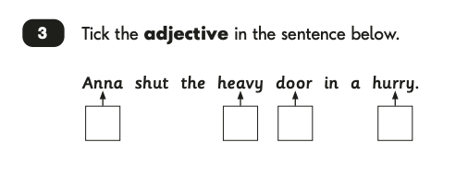
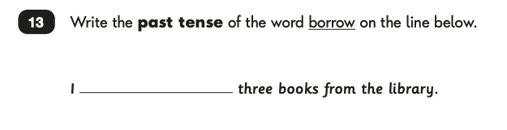
EGPS question examples

Slide 9
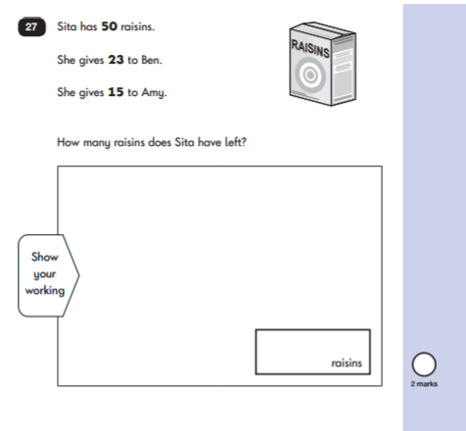
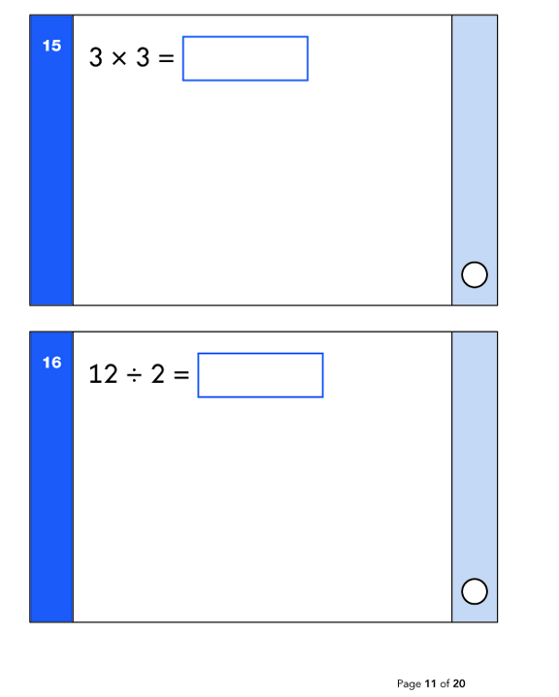
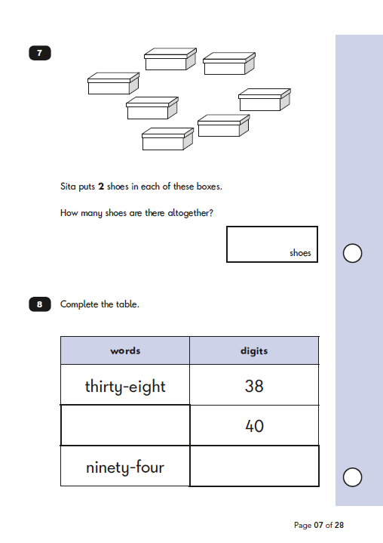
Maths question examples

Slide 10
How can I help my child?
Reading to and with your child is the most helpful thing you can do (not just for SATs)
At this stage it is not just about decoding. It is talking about the text, discussing the main events and locating information.

Slide 11
How can I help my child?
We work hard to support your child to achieve quality writing in Year 2 and to build up writing stamina.
Writing at home with notes, messages and shopping lists are a great way to support your child.
Supporting your child to use the four types of sentences would be a bonus.
Questions, exclamations, statements and commands.

Slide 12
How can I help my child?
Fluency with numbers is a great early skill and will help with the arithmetic papers.
Adding coins, telling the time, naming 2D and 3D shapes are all easy to do at home.
Counting in groups is also fab and its 2s 5s and 10s to master with the 3s as challenge.
We spend lots of maths lessons developing problem solving skills and the maths reasoning paper brings all the maths together.
Try and discuss maths in everyday settings. For example Reading scales when cooking. Cutting up pizzas into quarters. Matching up socks and counting in 2s.

Slide 13

Any questions?

