Slide 1
Monday 29th January 2024
Parent Phonics and Early Reading Workshop

Slide 2
Phonics is…
making connections between the sounds of our spoken words and the letters that are used to write them down.

Slide 3
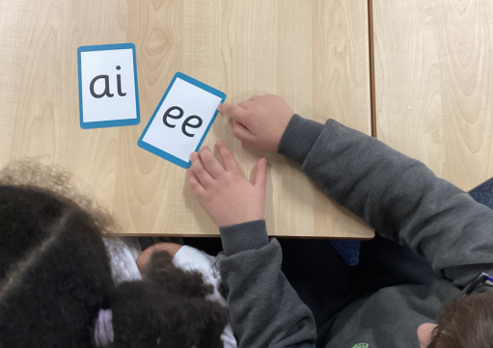
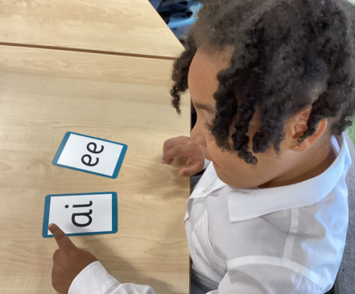
Terminology recap
Phoneme
Grapheme
Digraph
Trigraph
Blend
Segment

Slide 4
This term we are teaching phase 3
Last term we taught your child to blend and read words with Phase 2 graphemes.
In Phase 3 children learn:
the vowel digraphs and trigraphs
to read words containing the Phase 3 digraphs and trigraphs
to read longer words (‘chunking’).

Slide 5
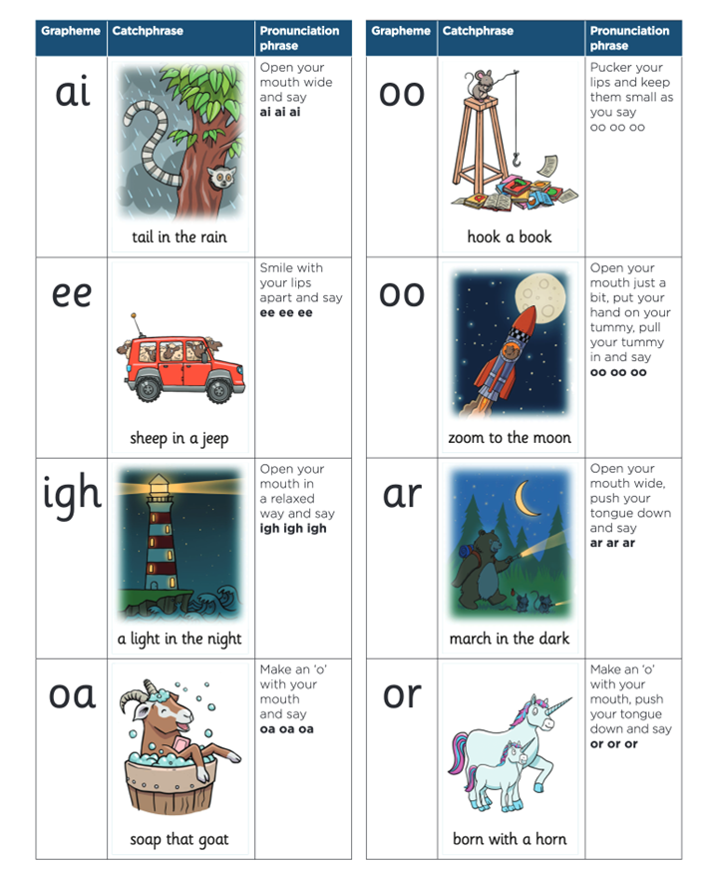
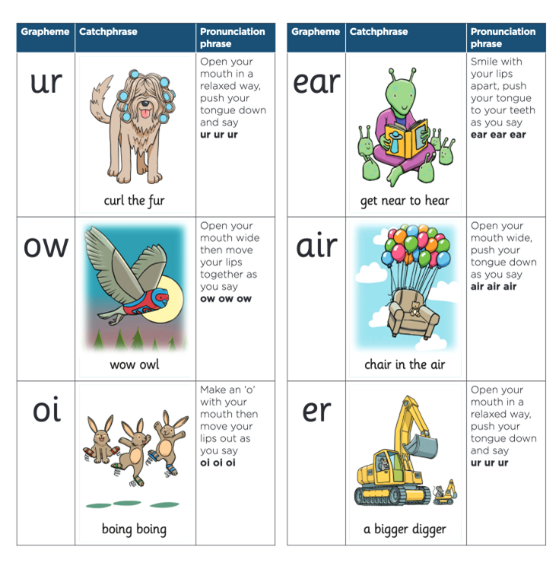
Phase 3 vowel digraphs and trigraphs

Slide 6
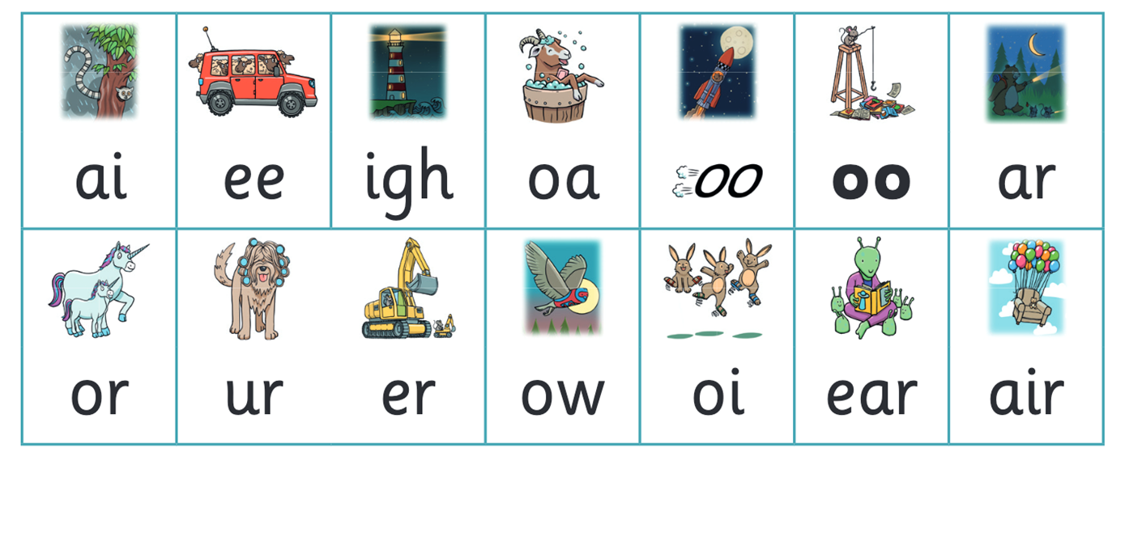
Let’s say the sounds together

Slide 7
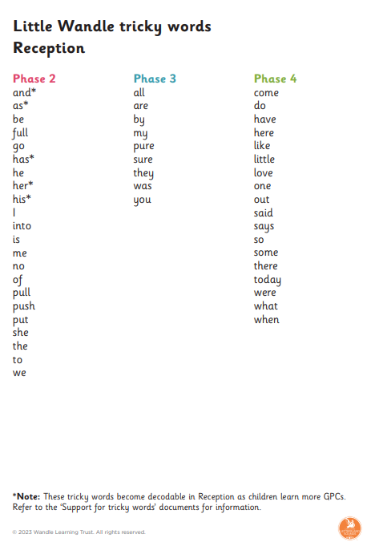
Tricky words
Tricky words continue into year one so it is important for children to secure these words.

Slide 8
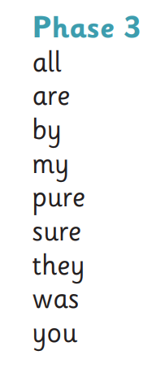
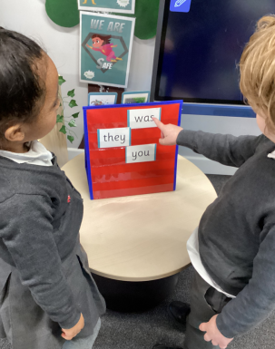
Tricky words
During Phase 3, children are taught more tricky words that they need to read by sight. This is why it’s important to help them secure their tricky words as we progress.

Slide 9
Reading longer words
During Phase 3, we start teaching children how to read longer words.
We do this using a method called chunking.
https://www.littlewandlelettersandsounds.org.uk/search/?_search=reading%20longer%20words

Slide 10
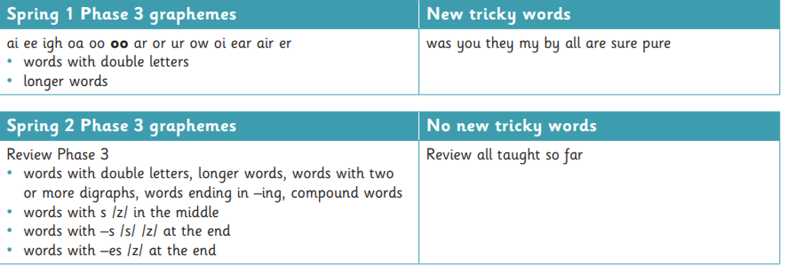
Phase 3 order of learning
Note – compound words are words made up of 2 words. For example – firefighter, starfish, cowboy.
Example – z sound. middle s – visit. end s – queens, chairs. es – torches, fishes

Slide 11
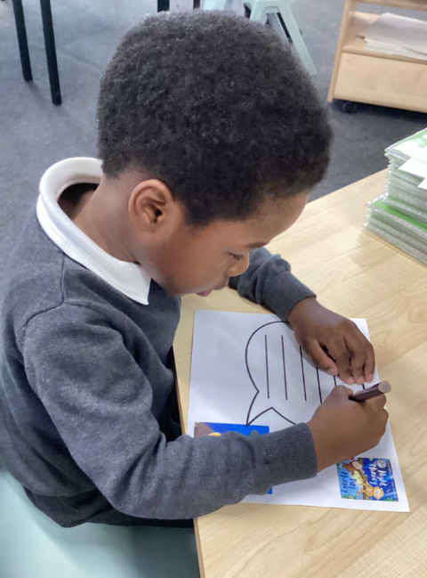
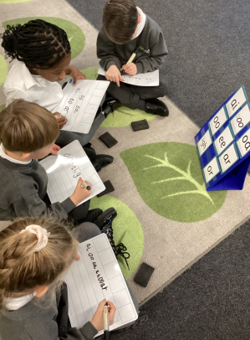
Writing
This term, your child will be taught how to spell words every day using the graphemes they have been taught so far.
They will practise writing a dictated sentence.

Slide 12
Let’s have a go at writing together
Say the word.
Segment the sounds.
Count the sounds.
Write them down.
Now let’s try a senetence.

Slide 13
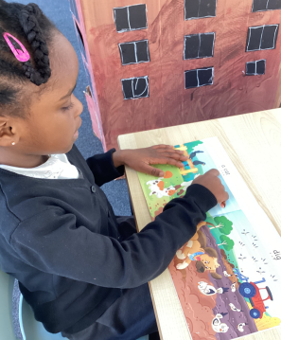
Books going home, a reminder

Slide 14
The importance of a strong foundation
Children are made readers on the laps of their parents.
― Emilie Buchwald

