Slide 1


Ignite the spark, reveal the champion
Welcome Meeting
EYFS at LWP
2024
Miss C Ingrams
Headteacher
Mrs A Holdsworth
EYFS Lead & Reception Teacher
Notes:
Welcome CI and over to AH

Slide 2
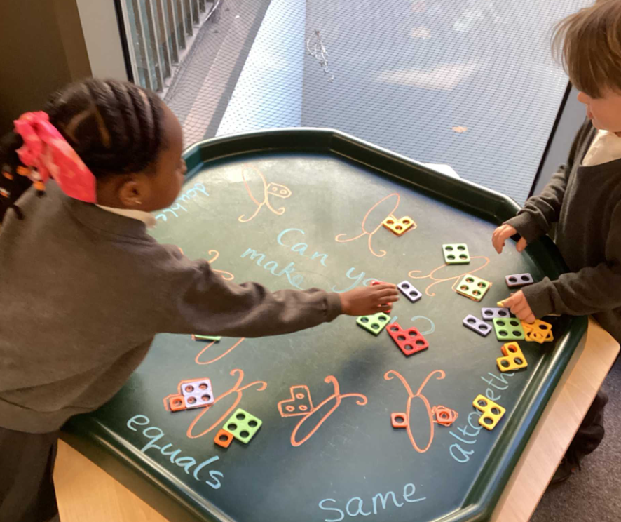
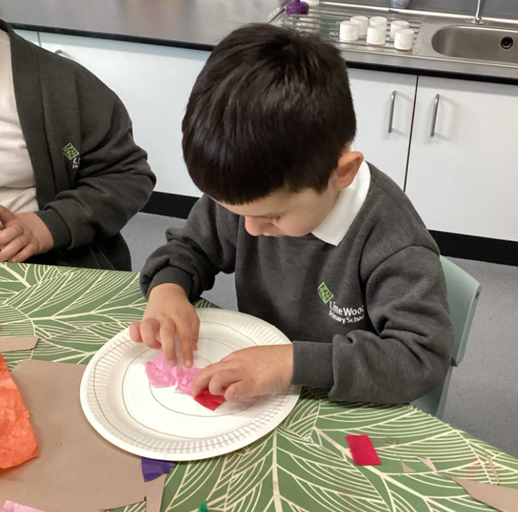
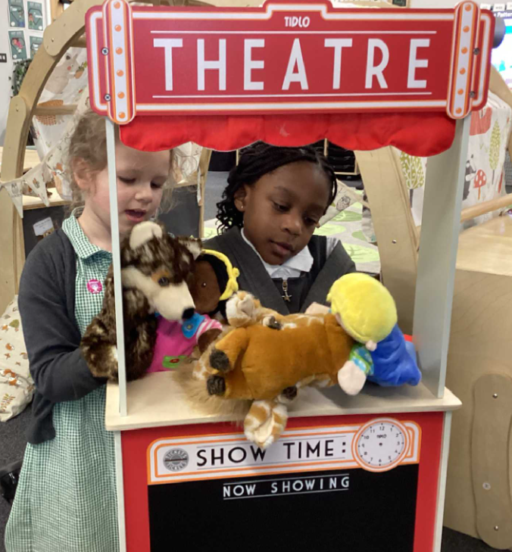
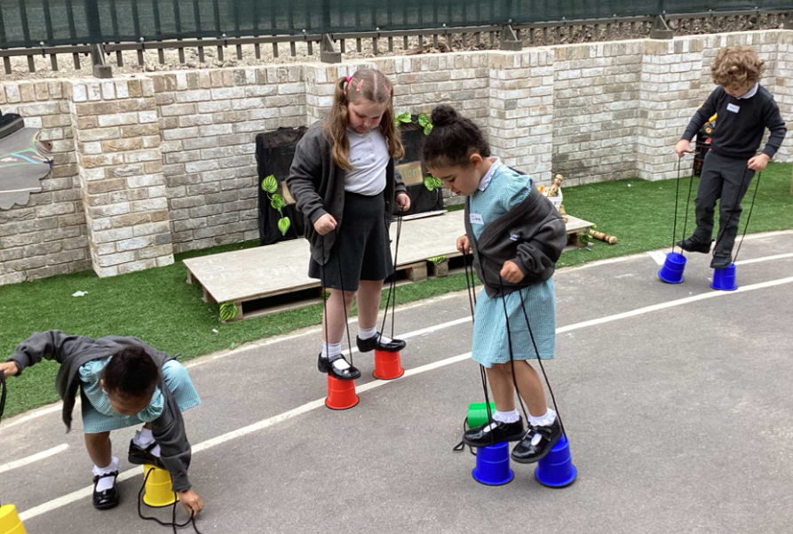
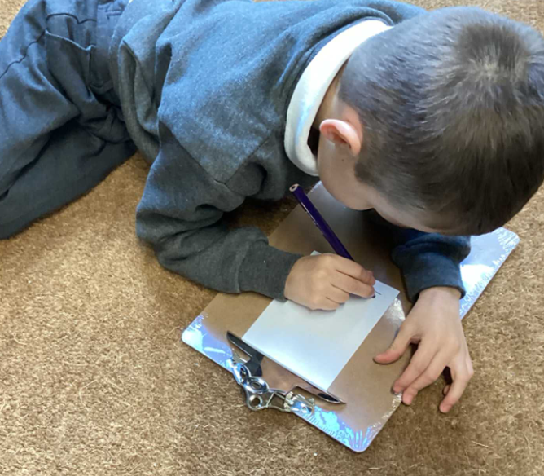
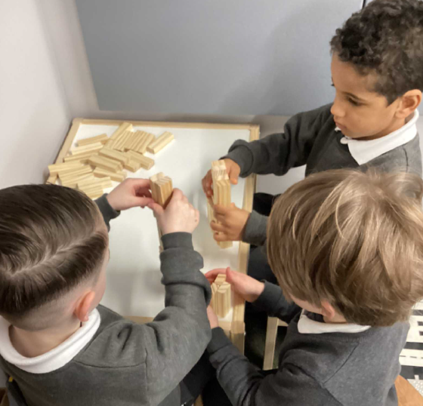
Welcome to Lime Wood
Primary School

Slide 3

School Values

Slide 4
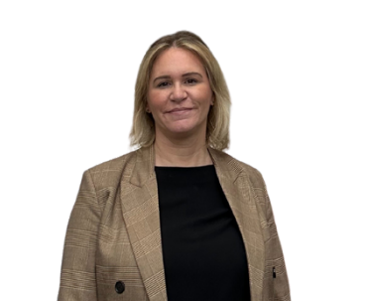
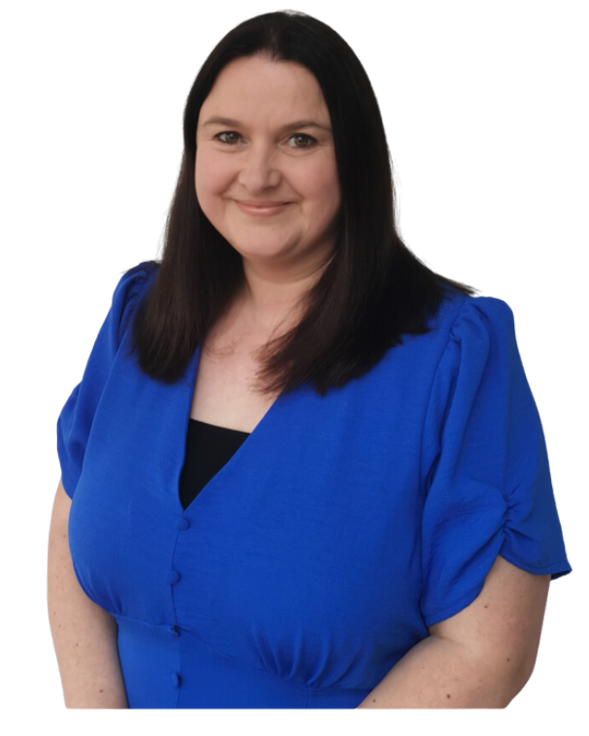
EYFS Teachers
Mrs A Holdsworth
Reception
Class Teacher
EYFS Lead
Neverwood Forest Class
Mrs A Webber
Reception
Class Teacher
Hundred Acre Wood Class
Notes:
CI

Slide 5
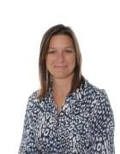


EYFS Support Staff
Teaching Assistants
Midday Meal Supervisor
Mrs Mogford
PPA Cover – PE
Coach Gurd
We are currently recruiting and will share details as soon as possible.
SEN Admin Assistant
Mrs Gregory
Notes:
CI

Slide 6

Inclusion & Safeguarding
Miss Ingrams
Headteacher & SENCo
Trust Inclusion Lead & Designated Safeguarding Officer
Notes:
CI

Slide 7
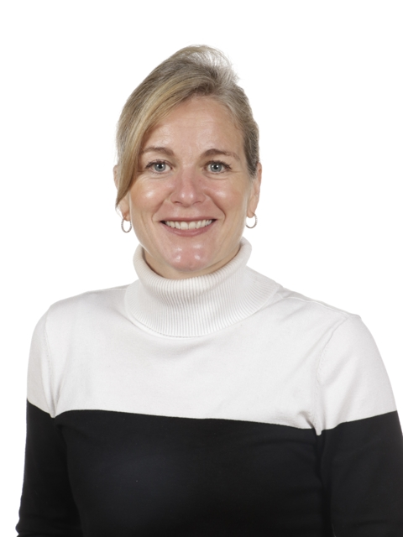
Front Office
Mrs Cunningham
Senior Office Administrator
Notes:
CI

Slide 8
Woodland Academy Trust
Lime Wood Primary School is part of the Woodland Academy Trust. Schools within the trust work in collaboration, sharing good practice to ensure every child, in every school achieves their full potential.
For more information, please do visit the trust website and the school website at
www.woodlandacademytrust.co.uk
Lime Wood Primary School
Notes:
CI

Slide 9


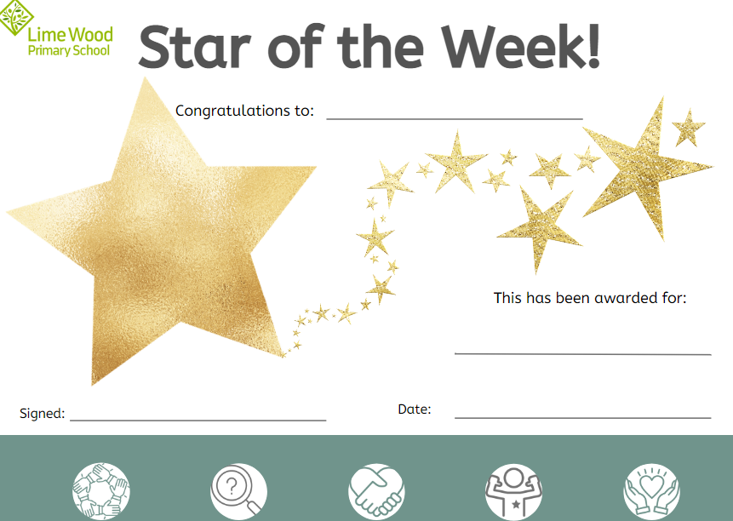
Behaviour & Relationships
EYFS follow the three rules:
Ready
Respectful
Safe
Children’s names are written in the Golden Book weekly for demonstrating excellence in learning and behaviour.
Postcards are sent home to parents to celebrate child’s achievements. Children are also selected each week to be Star of the Week!
Notes:
CI

Slide 10
EYFS Curriculum
The EYFS is a curriculum that focuses on the distinct needs of children from birth to five.
It is a broad, balanced and purposeful curriculum and is delivered through planned play based activities which are both adult led and child led.
We provide a balance between adult-led and child initiated experiences. Children are supported in their development through play and exploration opportunities, short carpet sessions, and adult guided work.
Although the curriculum remains very play based, the balance shifts gradually through the Reception year towards more activities led by adults, to help children prepare for more formal learning in Year 1.
Notes:
AH

Slide 11
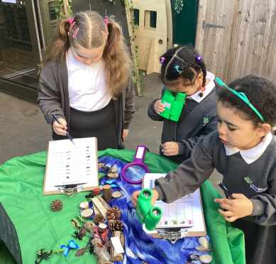
The Importance of Play
Through play children use the vital skills they have already mastered to extend their knowledge and understanding of the world.
Children feel comfortable and confident when they are playing so are able to experiment, take risks, question and explore.
Through exploration children make connections, build up ideas, concepts and skills.
Through play children gain a sense of achievement, thereby developing self-esteem.
Play is a vital tool to support emotional, cognitive and physical development.
Notes:
AH

Slide 12
Areas of Learning and Development
The Prime Areas:
  Communication and Language
  Physical Development
  Personal, Social and Emotional Development
  These areas help your child to build the capacity to learn.
  The Specific Areas:
  Literacy
  Maths
  Understanding the World
  Expressive Arts and Design
  It is through these that the Prime Areas are strengthened and applied.
Notes:
AH

Slide 13
Characteristics of Effective Learning
Playing and Exploring
Active Learning
Creating and Thinking Critically
Finding out and exploring
Using what they know in their play
Being willing to have a go
Being involved and concentrating
Keeping on trying
Enjoying achieving what they set out to do
Having their own ideas
Using what they know in their play
Being willing to have a go
They detail the ways in which children should be learning from their environment, experiences and activities.
Children up to the age of five should all be displaying the characteristics of effective learning every day.
Notes:
AH

Slide 14
How will your child learn?
We teach using topics as well as using the children’s interests as a vehicle for learning.
Each morning the children will be taught phonics and literacy and in the afternoon maths/topic.
Children will follow the EYFS curriculum
Notes:
AH

Slide 15

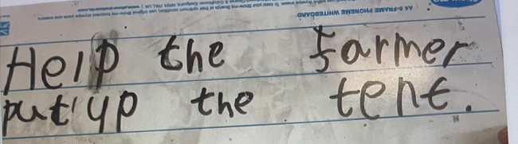
Literacy
In EYFS and across the school we use elements of Talk4Writing which enhances children’s ability to learn and retell stories both orally using actions and written.
Children are taught to read primarily using a structured phonics programme. At LWP, the Little Wandle Letters and Sounds programme is followed for all children. There is a daily phonics session and children are regularly assessed to identify any gaps in learning. Within the school day identified children will join a phonics catch up session.
Children have 3 reading sessions over the week. 1 Decoding, 2 Prosody 3 Comprehension. Children take these books home and read with their grown-ups
Notes:
AH

Slide 16
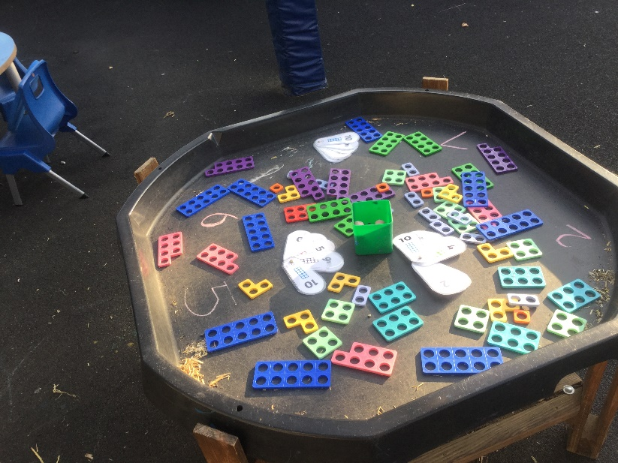
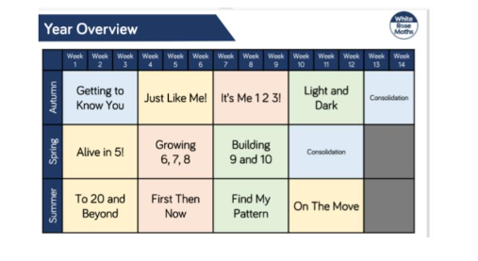

Maths
At the Woodland Academy Trust, all pupils will experience the ‘mastery approach’ to learning maths, using the underlying principles of White Rose. Instead of learning mathematical procedures by rote, we want pupils to build a deep conceptual understanding of concepts which will enable them to apply their learning in different situations.
Notes:
AW

Slide 17
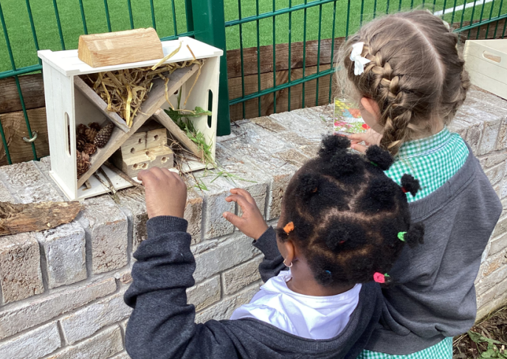
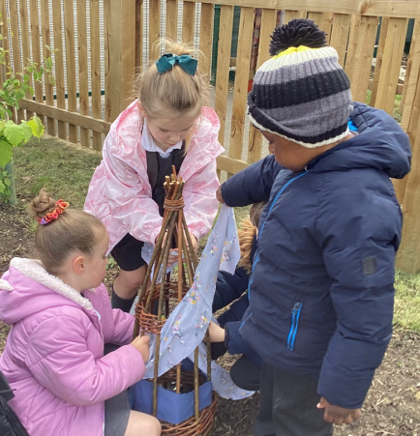
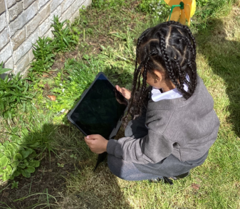
Outdoor Learning
Our belief is that children can excel, extending beyond the traditional curriculum, and we offer a strong emphasis on outdoor and adventure learning.
Outdoor learning is a holistic approach to learning, where children explore the setting and engage in exciting activities.
These will include:
Digging
Mud kitchen
Sawing
Drilling
Bug hunting
Cooking
Knots and lashings
Den building
Notes:
AW

Slide 18
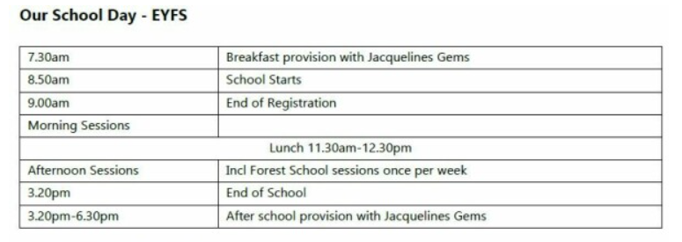
Gates will open from 8.45am for morning drop off (8.50am) and from 3.15pm for collection. Classroom doors will open at 3.20pm.
Notes:
AW

Slide 19
Beginning of the school day
Children will enter their classroom independently and be supported by staff to put their belongings away.
They will then sit on the carpet for early morning work.
If there are urgent messages for your child’s teacher these can be passed on in the morning, non-urgent please let the office know. Please remember staff are there to support all children settle into the class each day and therefore children are their priority.
If you have anything of length you wish to discuss we ask you to contact the office to book an appointment with the class teacher.
Notes:
AH

Slide 20
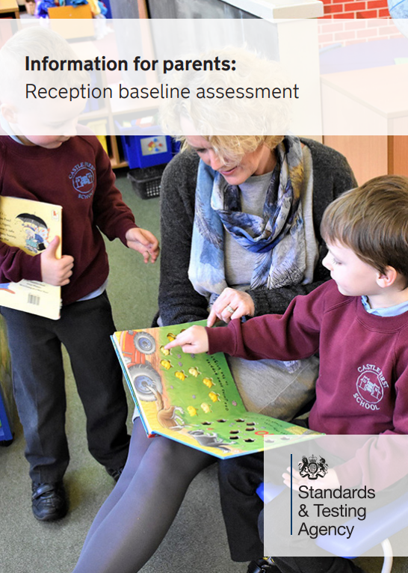
Reception Baseline Assessment
The purpose of the assessment is to provide the starting point for a new measure that will help parents understand how well schools support their pupils to progress between reception and year 6.
The RBA is a short, interactive and practical assessment of your child’s early literacy, communication, language and mathematics skills when they begin school, using materials that most children of your child’s age will be familiar with.
It became statutory for all schools from September 2021.
https://assets.publishing.service.gov.uk/media/64f5e8b29ee0f2000db7be4f/2023_Information_for_parents_reception_baseline_assessment_WEBHO.pdf
Notes:
AH

Slide 21
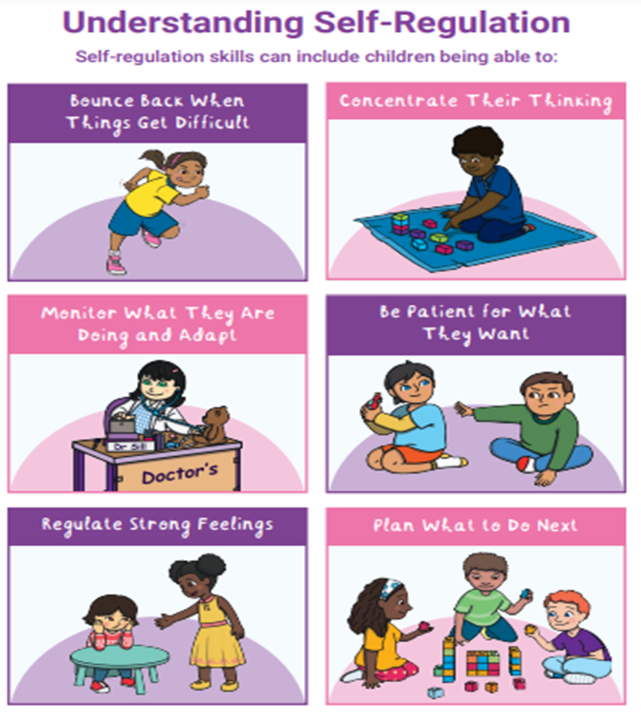
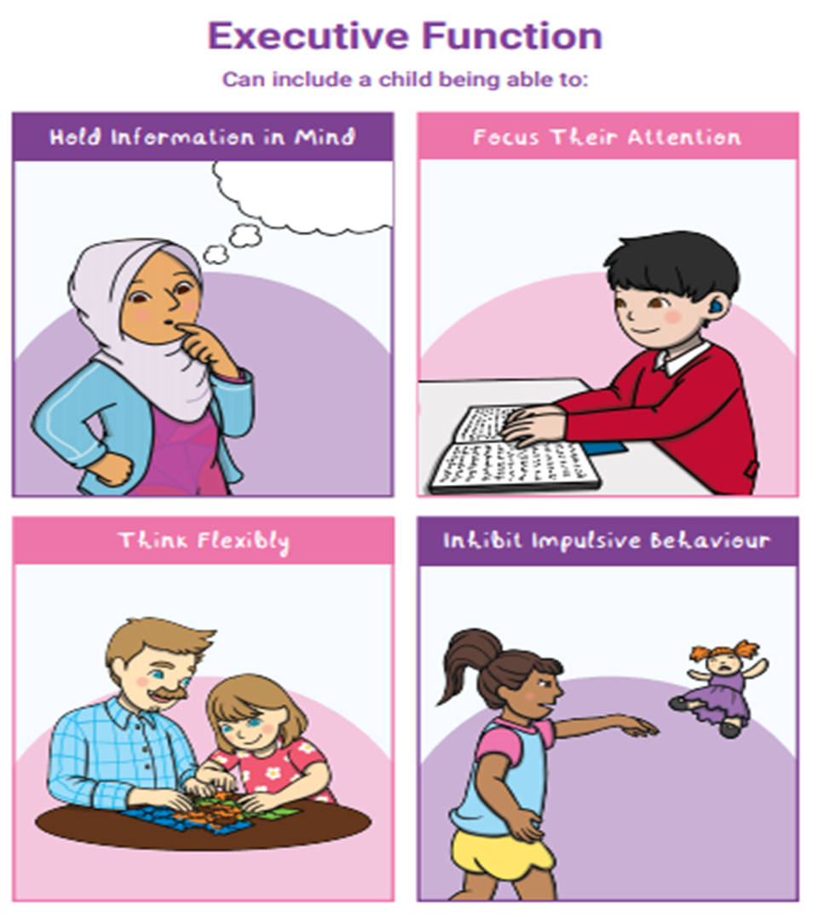
Notes:
AH

Slide 22
How do we know your child’s capabilities?
Observing children playing
Small group activities
Talking and questioning
Class/group discussion
Communication with parents/carers
On-going/termly assessment
Showbie
Floor Books
Notes:
AH

Slide 23
Physical Development/PE
PE clothes in a clearly named PE bag.
PE kit- black shorts/trousers and white polo shirt/t-shirt, velcro trainers, spare underwear.
No earrings/jewellery. Should your child come to school with stud earrings they should be taped over. Shoulder length (or longer) hair should be tied up. Children will change independently so please help them practice at home to dress and undress themselves without help.
Label everything!
Notes:
AH

Slide 24
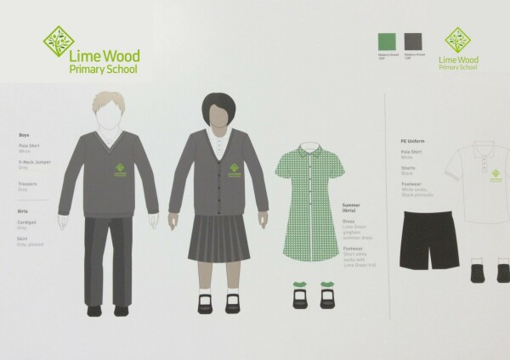
School Uniform
Preferably Velcro fastenings on shoes as laces are a tripping hazard.
Notes:
AH

Slide 25
Parents as Partners
We highly value the partnership between home and school, and encourage all parents and carers to take an active part in the education of their children.
Read with your child daily and record in reading record book
School visits
Home learning
Showbie
Workshops
Please join our PTFA to support the school to fundraise for all the children.
Email – ptfalwp@gmail.com
Notes:
CI

Slide 26

Lunch & Free School Meals
All children in Reception receive free school meals.
This is called Universal Free School Meals. We encourage all children to try school dinners, however if preferred, they can bring their own lunch.
In the packs you have been given you will find our menus. You will also find suggestions for a healthy packed lunch.
If your child has allergies or dietary requirements we will record these in the admission pack that you will be completing soon. If your child has aversions to food, depending how severe, we encourage you to make food similar to themenu so they can try it, where possible. You may also like to put their lunch in their lunchbox to get them used to opening and closing it.
In your packs you will find information about our catering company, The Pantry. All meals are booked directly with them. Please remember to register for your account and select your child’s meal choices on a weekly basis.
Notes:
CI

Slide 27
What does your child need in school?
A spare change of clothes if your child is likely to have an accident.
Children need to bring a named water bottle with them every day.
We go outside in all weathers. Please provide wellington boots and a waterproof all in one for your child in a clearly named bag.
Label everything!
A named sunhat in the hot weather.
Notes:
AW

Slide 28

Showbie
We will be using Showbie to gather and share your child’s learning, capturing those wonderful moments we do not want you to miss!
You will receive a letter providing instructions for access alongside a pin code.
Notes:
AH

Slide 29
Extra curricular opportunities
This year we have been delighted to be able to offer lunchtime clubs for our Reception cohort.
This will continue next year with opportunities available throughout the academic year.
Jacqueline’s Gems also offer after school extra-curricular clubs too!
Notes:
AH

Slide 30

Breakfast & Afterschool Club
Jacqueline’s Gems
Start: 7.00am
Close: 6.30pm
Call 01322 351 594
Notes:
CI

Slide 31




Transitions
Preparing your child for going to school:
https://www.maslaha.org/post/getting-ready-for-reception
Notes:
AH

Slide 32

Transitions
Born Ready, School Ready, Bexley Ready
This can also be found on the school website under the Useful Links section (EYFS).
Notes:
AH

Slide 33

Transitions
Hungry Little Minds
The focus for the project is to highlight simple and fun activities for families to complete together.
Visit their website at
https://www.nhs.uk/start-for-life/toddler/learning-to-talk/learning-to-talk-3-to-5-years/
Notes:
AH

Slide 34
Home Visits & Start Date
Home Visits will be conducted by Mrs Holdsworth and Mrs Webber on the first two days of Autumn term – 5th and 6th September 2024.
First morning in school will be 9th September 2024 – until 12.30 (after lunch).
The first full day (850-320) will be 10th September 2024.
Notes:
AH – This is a change to what has previously been said.

Slide 35
Common parent worries
Feeling emotional about leaving your child especially if they become upset
Being unsure about what happens at school
Practical concerns such as ‘will my child be able to find the toilet?’
Will my child make friends?
Notes:
AH

Slide 36
How to help your child feel confident when starting school
Let your child become independent they will still want lots of cuddles
Coats and jumpers
Putting on and taking off their own jumper/cardigan
Nose wiping
Lunchtimes
Names
Toileting
Washing hands
Notes:
Ideally your child should have a coat with a hood so they can hang it on their peg easily.
Quick coat trick – place on floor hood to feet and put hands in holes then flick over head. Help your child practice putting their own jumper/cardigan on and being able to correct the sleeves if they turn inside out
Nose wiping - It’s a good idea to let your child look in a mirror to wipe their own nose so that if I direct them to wipe their nose they know how to do it independently
Lunchtimes - Help your child to be confident at lunchtimes by letting them use a knife and fork at home to eat their meals. Help them learn how to hold food with the fork and cut the food with their knife
Names – It is really helpful for your child if they can recognise their name so they can find their peg as well as find their name card to practice writing their name. Please be aware that if you are helping your child write their name that they only use a capital letter at the beginning of their name.
Toileting – children need to be able to use a toilet independently. This includes flushing the toilet and wiping themselves. Please talk to them to explain that if they have an accident they need to me so I can help them. (youtube balloon bottom wiping)
Handwashing is important for every childs health within the classroom so please help them by practicing and understanding how to use soap, rinse their hands correctly and dry their hands properly.

Slide 37
Communications
As there are many events that run throughout the school year, we like to keep Parents and Carers up to date. Please see a list of ways below that we communicate with Parents and Carers.
Website: www.limewoodprimary.co.uk
Arbor – This is an app that you can download to your phone. You will receive notifications, letters, newsletters, forms, consents and alike. You can also pay dinner money and book your child onto clubs, trips and manage Parent’s Evening appointments. We ask all Parents/Carers to ensure they have a working Arbor account as this will ensure that you are notified of any last-minute changes to events, as well as all important information. If you would like to sign up please give your email address to the front office who will send you a link for registration.
If you are having technical difficulties with Arbor please use the help guides https://support.arbor-education.com/ or speak to the front office.
Facebook – “Like” our Facebook page “LimeWood Primary School”
X – Follow us @LimeWoodWAT
Instagram – Follow us lime_wood_primary
Notes:
CI

Slide 38
Communications
Paper Copies – We try to help the environment by not sending too many correspondence by paper as we have many other resources to get information to you, however sometimes if there is an important notice we may send a paper letter. Please check your child’s book bags daily to check for information.
Weekly Newsletter – Our weekly newsletter is published every Friday. It will contain all important information. This is an information resource that we ask Parents/Carers to check each week. If you do not receive Arbor please check our website as our newsletters are uploaded there too. The office will be happy to print you a paper copy also.
Front Office – Mrs Cunningham in the front office will be happy to help you with any information that you require. Pop in, email LWPoffice@watschools.org.uk or call 01322 344939
Class Teachers – Class Teachers inform the pupils in their class about upcoming events, they will include details on Showbie to remind Parents and Carers about the events so please look out for this. Please also review the weekly newsletter for key information.
We hope that by using all of these channels of communication we ensure everybody is kept up to date.
Please ensure that you are also regularly checking these channels for information as it is all of our responsibility to keep up to date.
Notes:
CI

Slide 39
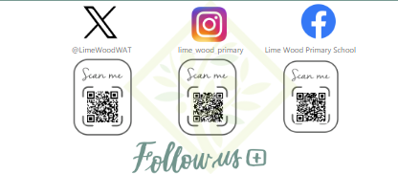
Social Media
Notes:
CI

Slide 40
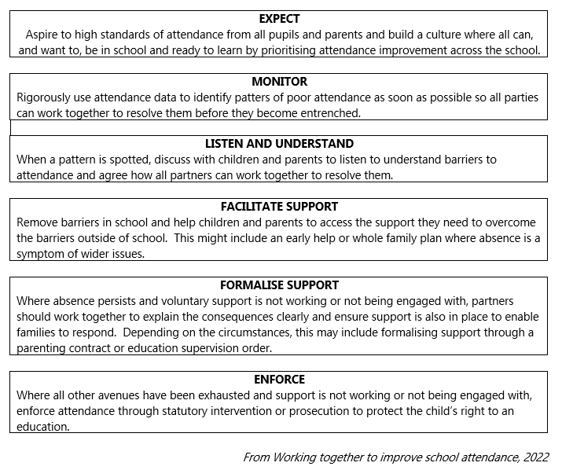
Attendance
Notes:
CI

Slide 41
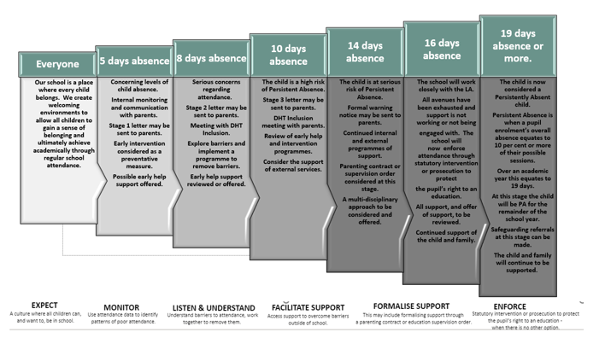
Attendance
Notes:
CI

Slide 42
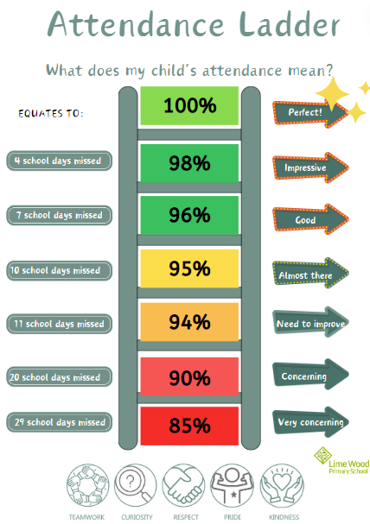
Notes:
CI

Slide 43
We cannot wait to work with you all.
THANK YOU
Notes:
ALL

Slide 44

Any Questions

