Slide 1


EYFS Parent Workshop
Making Maths Meaningful

Slide 2
EYFS Parent Workshop
Developing a strong grounding in number is essential so that all children develop the necessary building blocks to excel mathematically. Children should be able to count confidently, develop a deep understanding of the numbers to 10, the relationships between them and the patterns within those numbers.

Slide 3
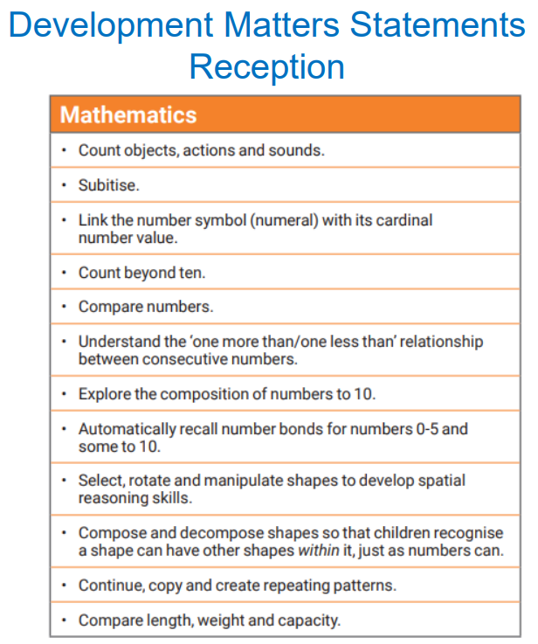
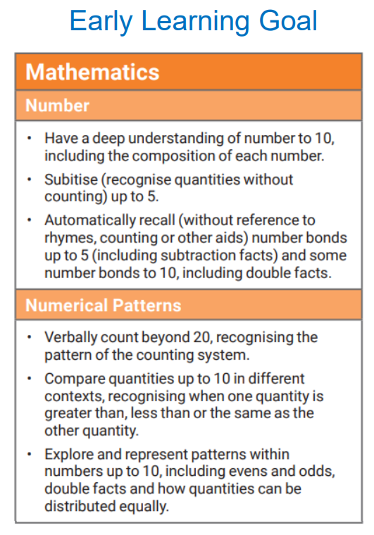
The Early Years Foundation Stage Curriculum

Slide 4
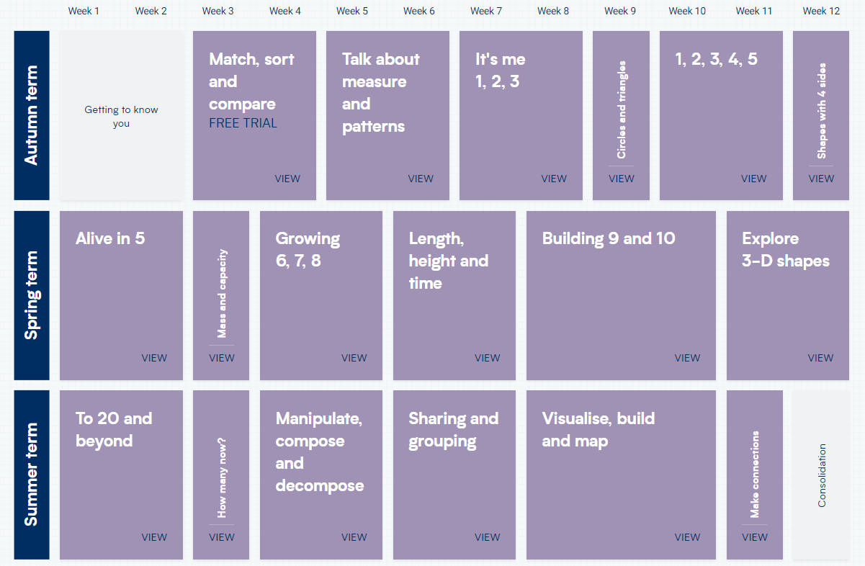
White Rose Maths
For each year group, the scheme of learning includes an overview of the maths that your child should be learning at any point in the year.
Each year is split into three terms (autumn, spring and summer), and each term comprises individual blocks of learning about a particular topic.

Slide 5
Maths in Lime Wood
Coherence
Children learn maths in small connected steps.
Representation & Structure
Children are encouraged to talk about what they see, compare and use mathematical language.
Fluency
The practice of core facts so children get quick and confident in Maths.
Variation
Children identify relationships, spot patterns, and use this to reason about new problems.

Slide 6
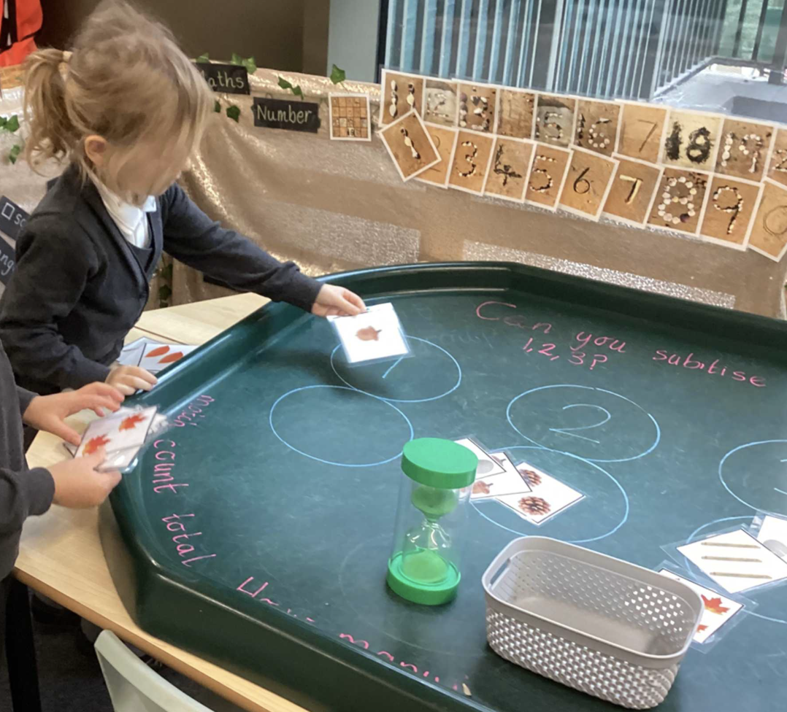
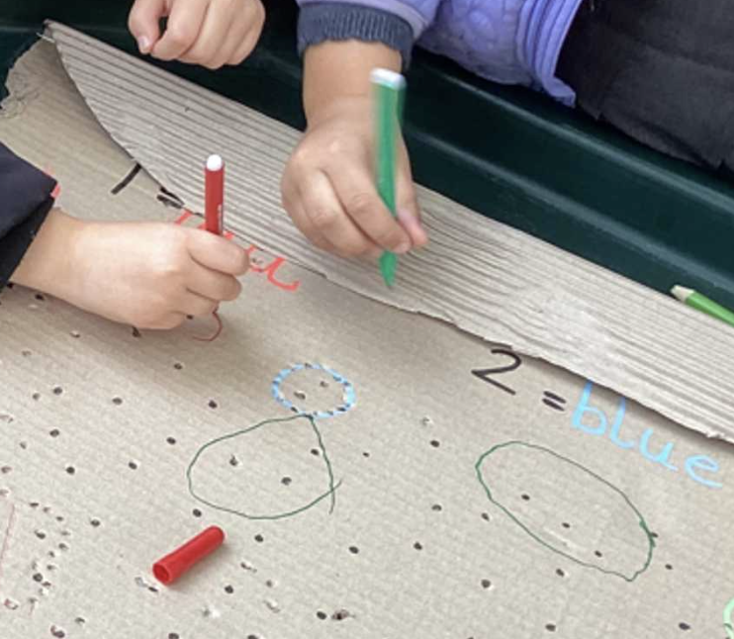
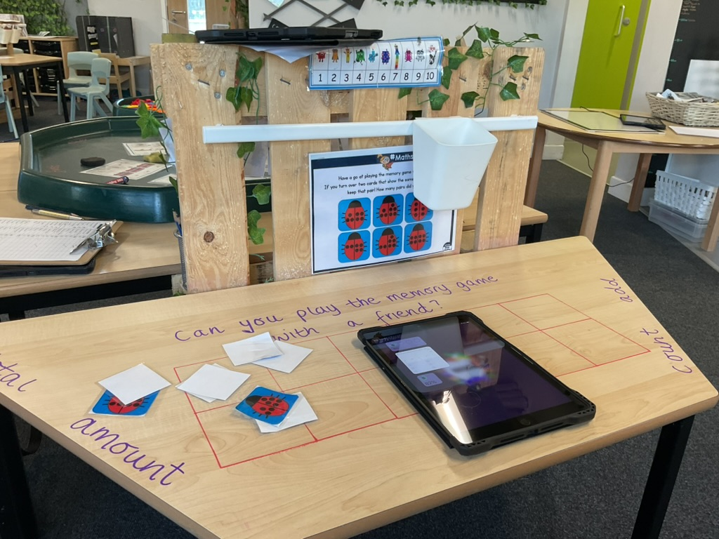
EYFS Maths
Number:
Counting
Subitising
Comparing

Slide 7
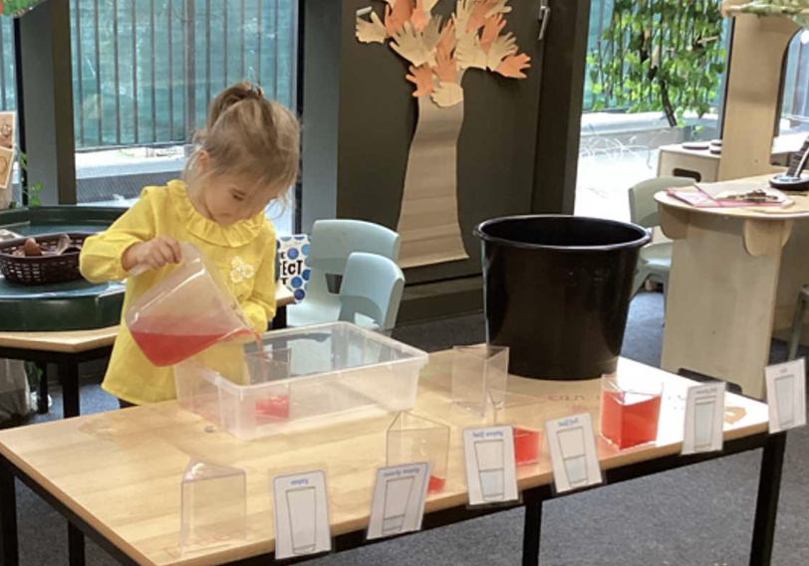
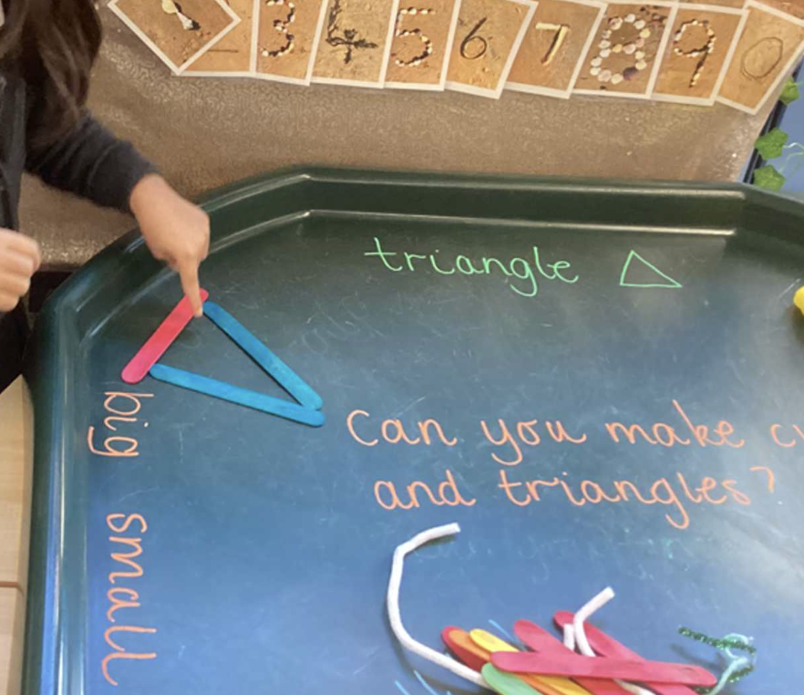
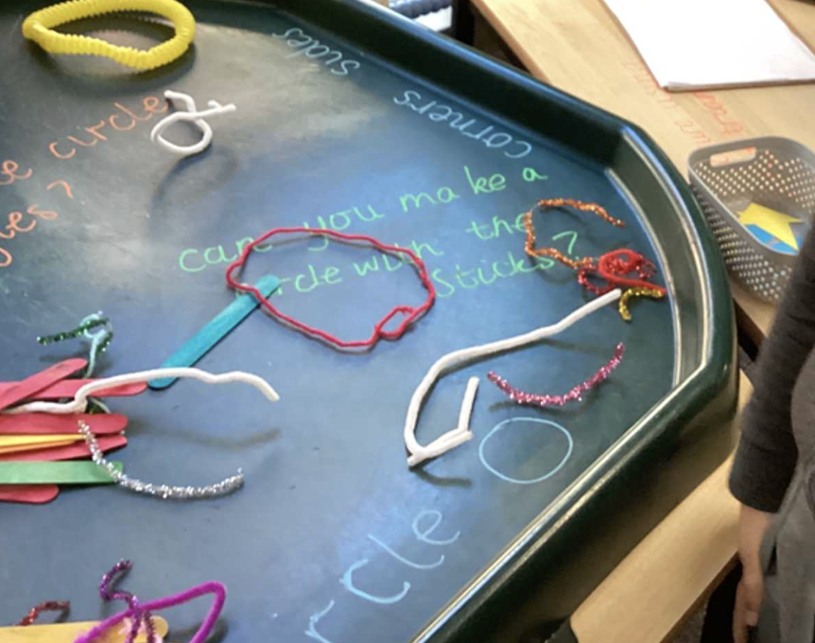
EYFS Maths
Shape, Space and Measure
Patterns
Size
Capacity

Slide 8

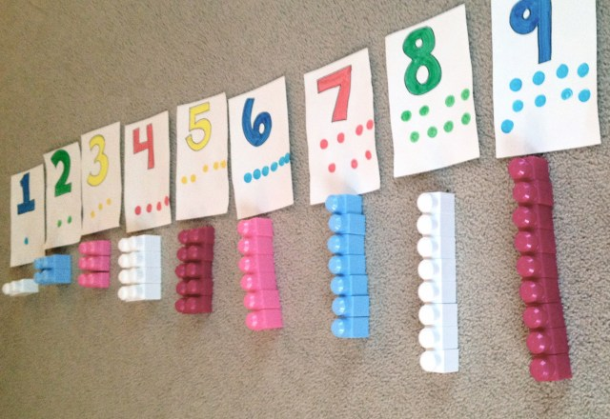
Small, connected steps
Before children can add, they first need to learn…
to count
to subitise
to explain what they see

Slide 9
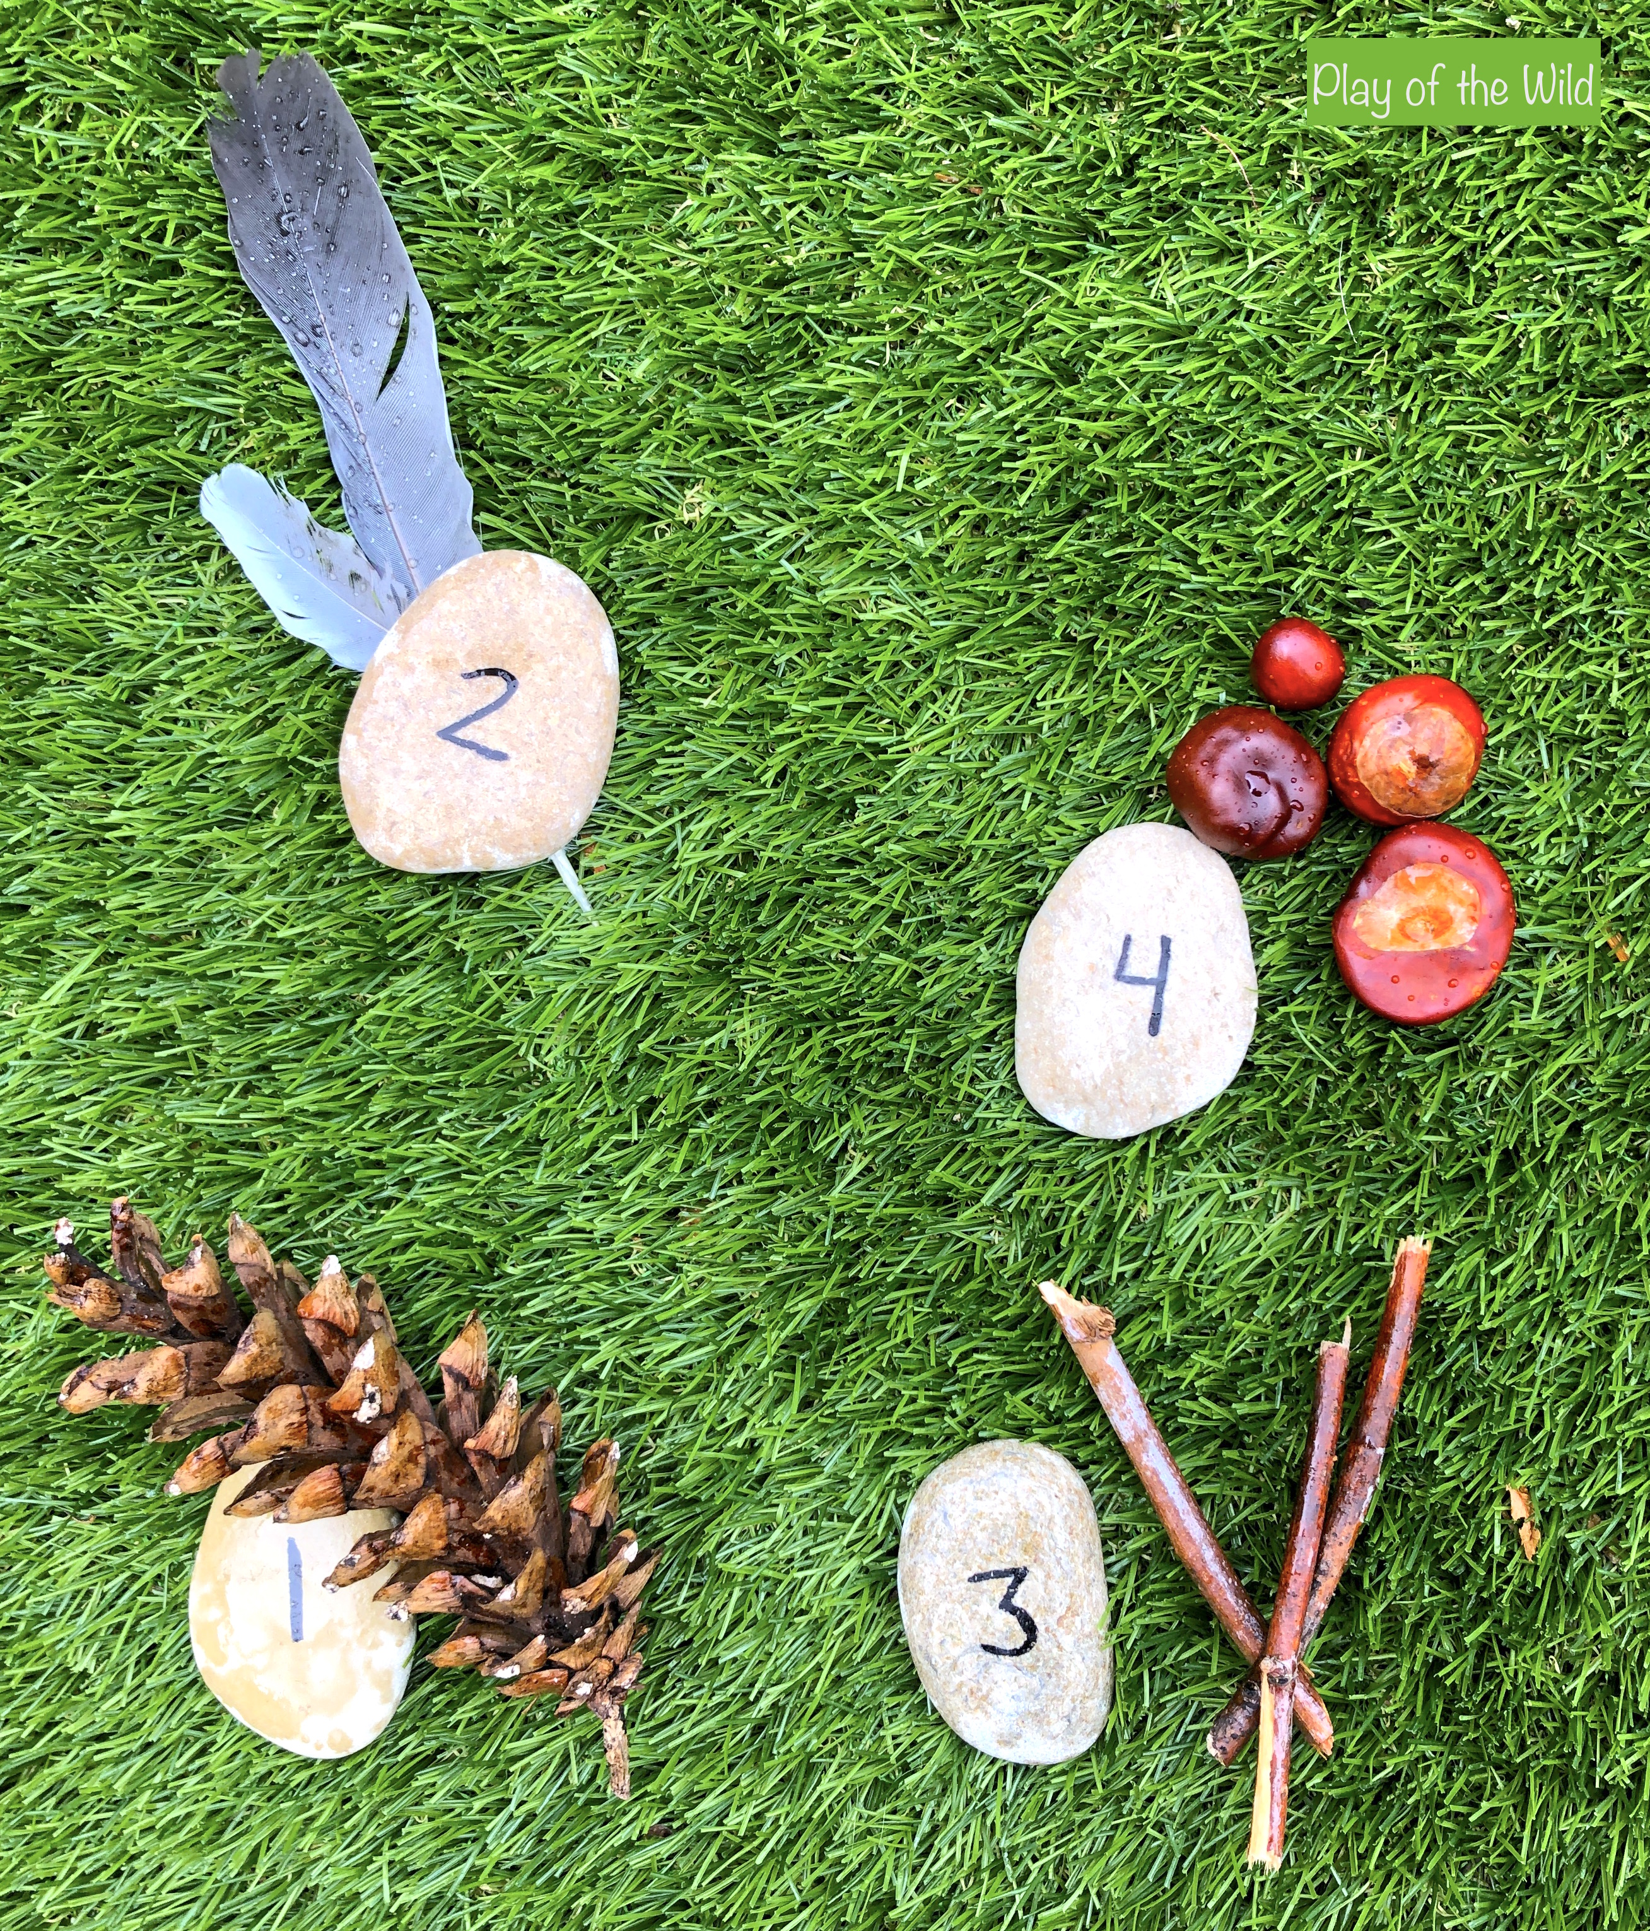
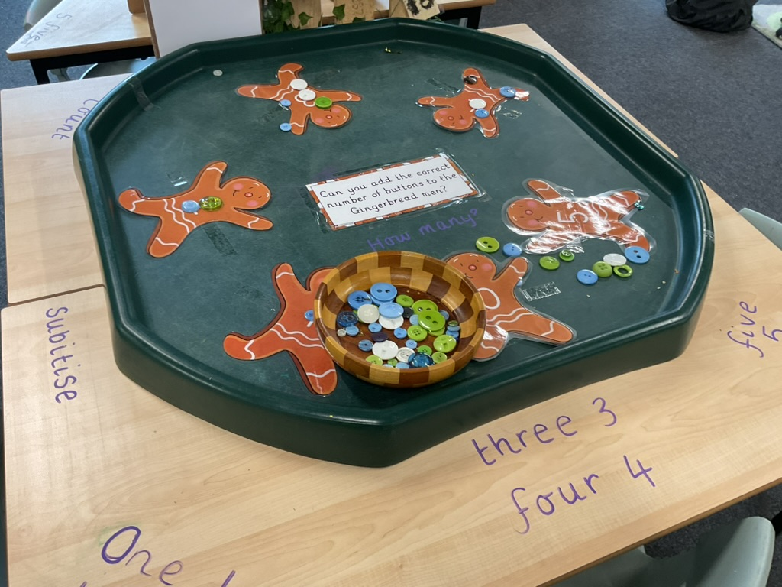
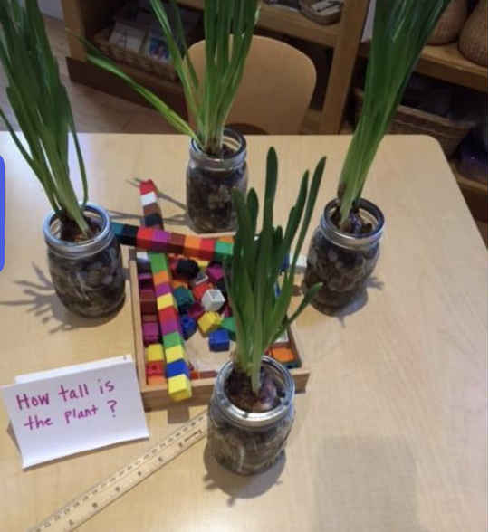
Use real objects and pictures
Children use real objects every day!
—cubes
- counters
- blocks
- water
- sand
- fruit
- toys.

Slide 10
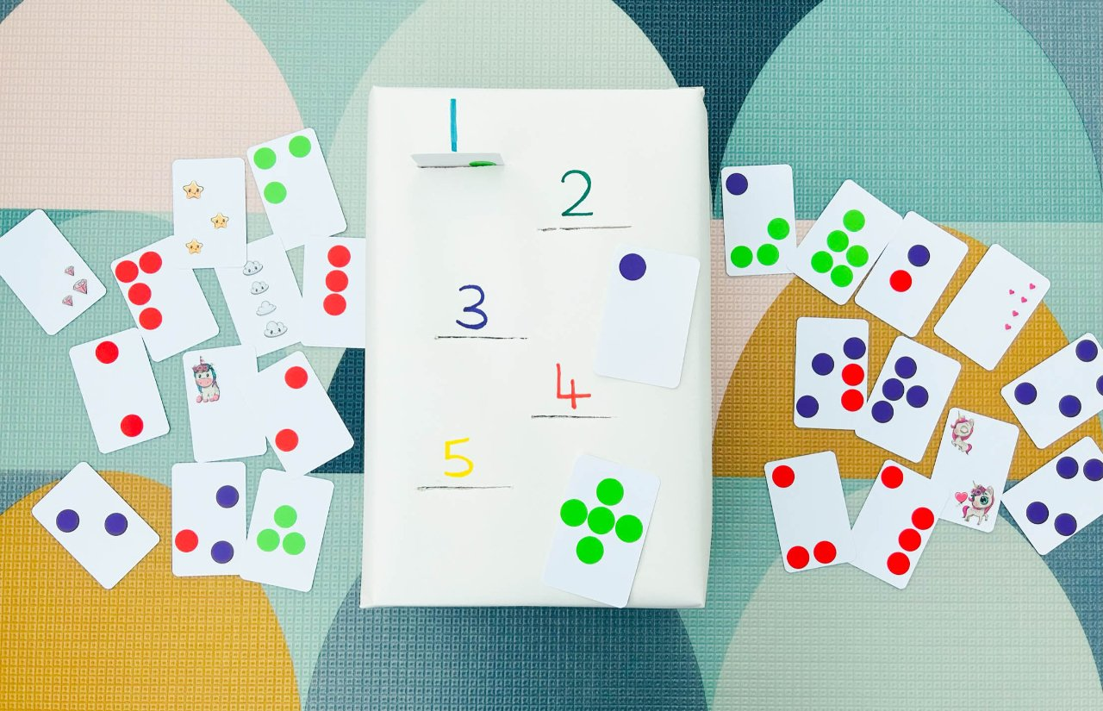
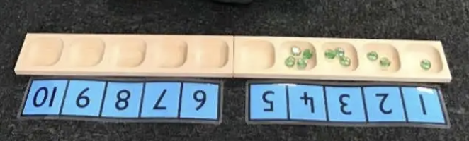
Repetition
- counting how many
children are in class
tidying toys into groups
sharing snack pieces
singing number songs
building towers.

Slide 11
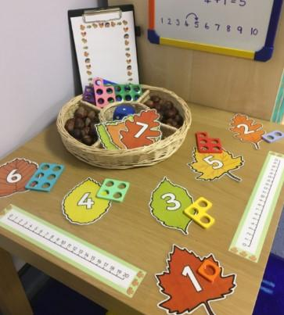
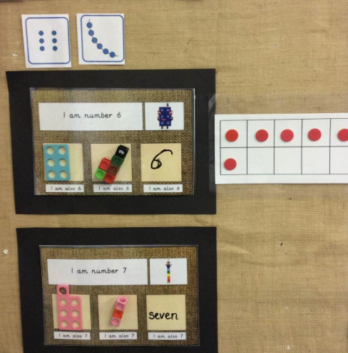
See Maths in different ways

Slide 12
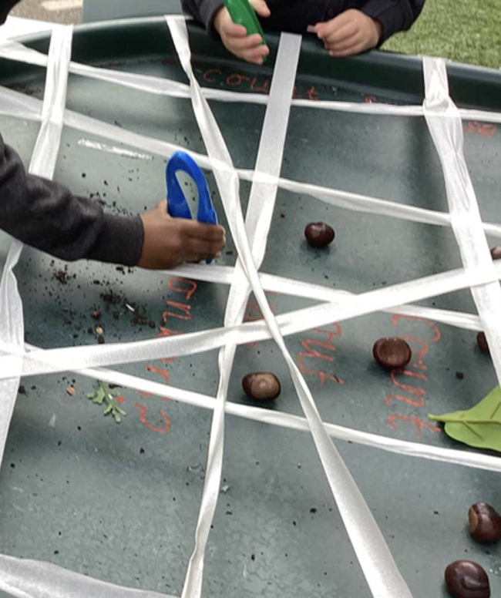
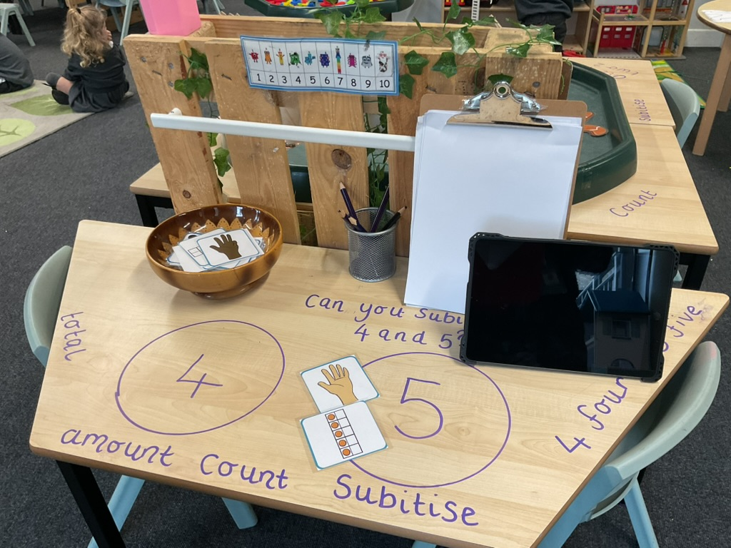
EYFS Maths Lesson

Slide 13
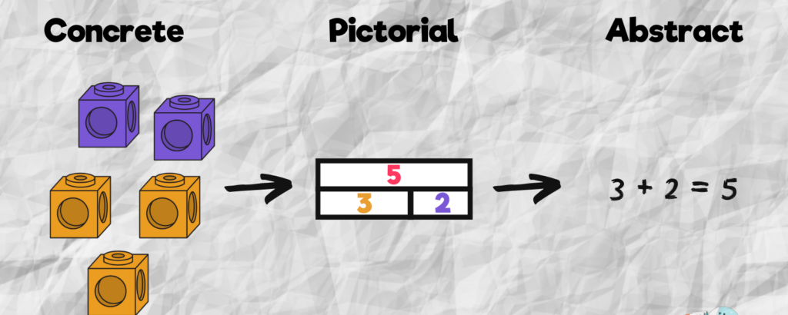
EYFS Teaching Approach
How do you know?
Maths Talk
Can you show me another way?
Tell me what you notice?
CPA Approach
Concrete

Slide 14
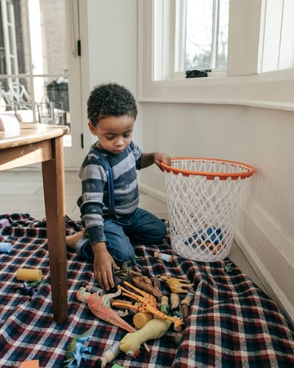
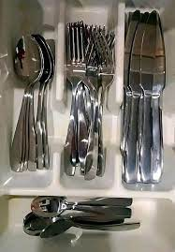
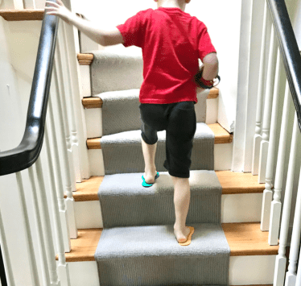
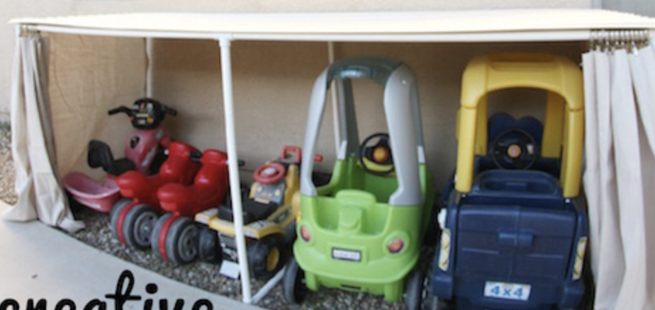
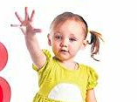
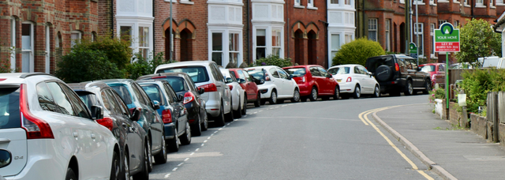
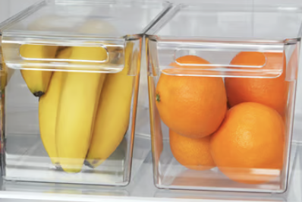
Maths at home
1. Counting in daily routines
2. Sharing and grouping during mealtimes.
Can you share these between us?
Do we have the same?
- Who has more?
How many did you count?
What comes next?
Did we count that one already?

Slide 15
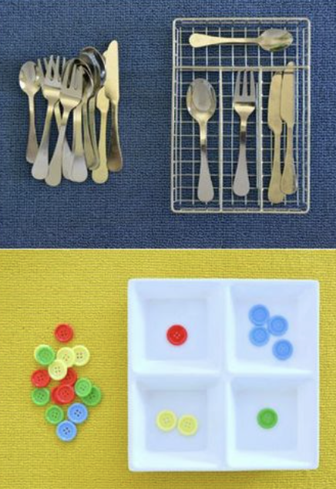
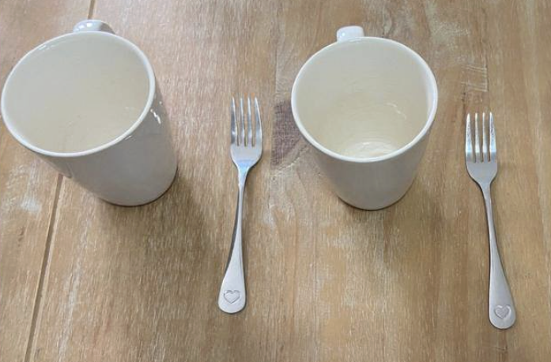
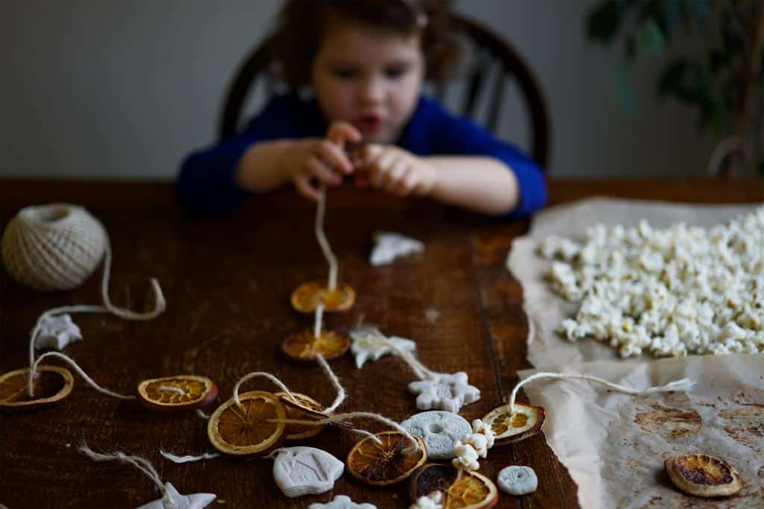
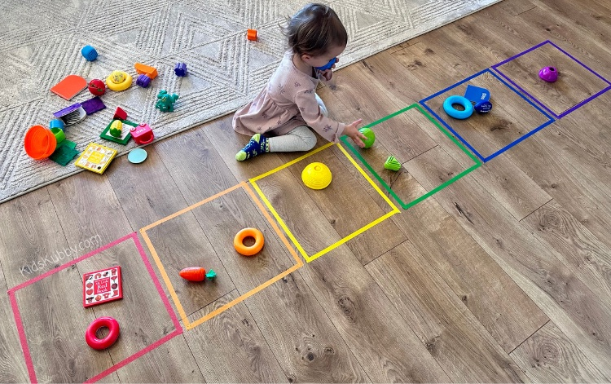
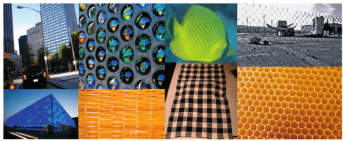
Maths at home
3. Spotting pattern around the home
4. Sorting and Matching during play
What pattern can you see?
Can we make a pattern with toys and colours?
What will come next?
Can you put all the small cars together?
Which ones match?

Slide 16
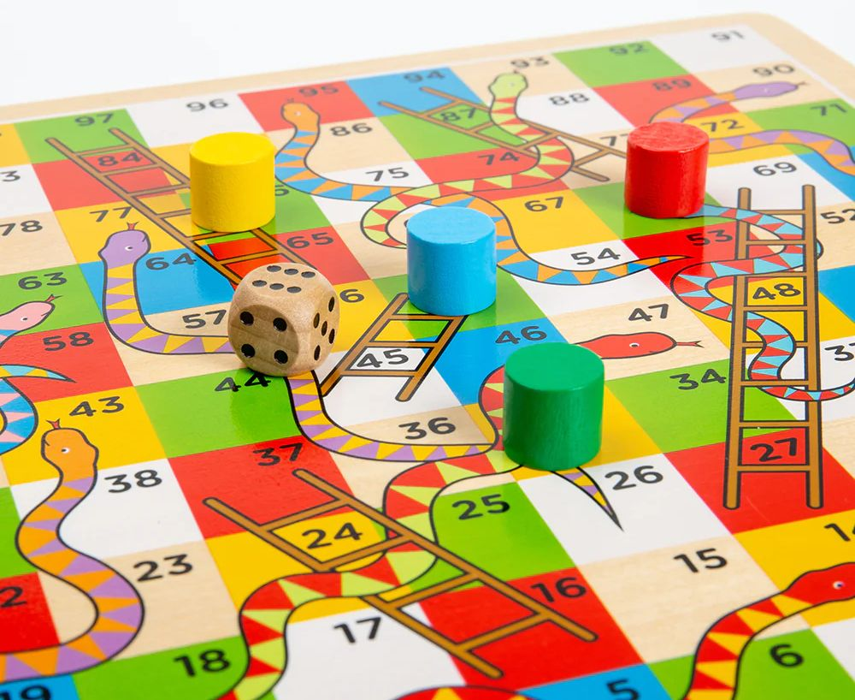

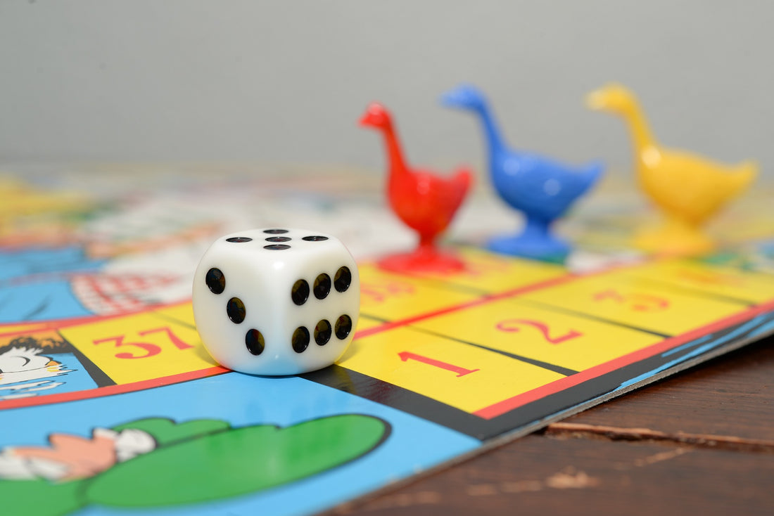
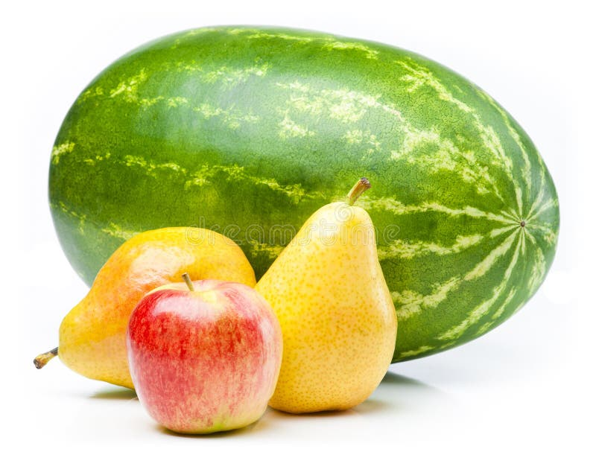
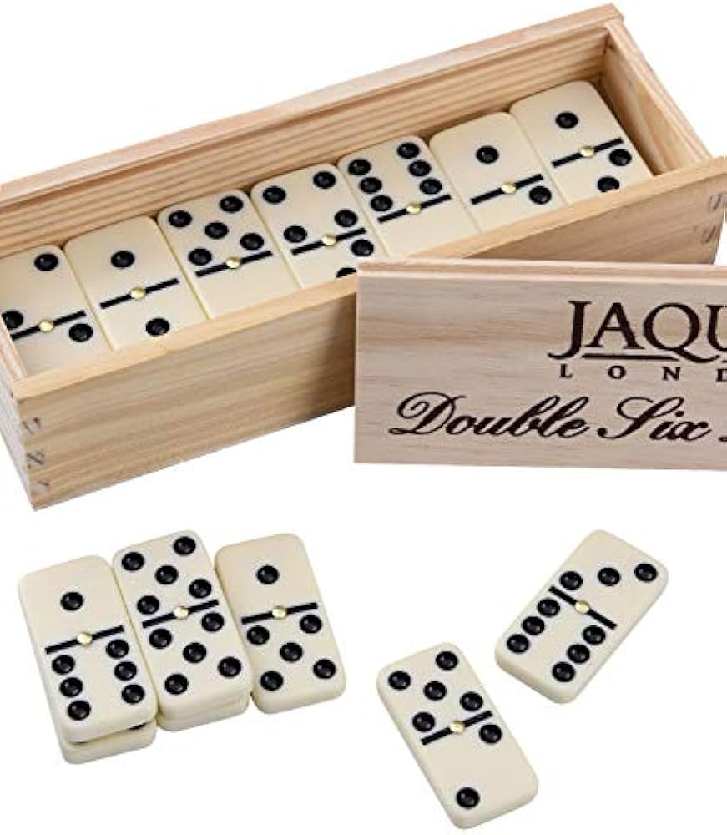
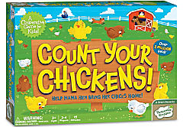

Maths at home
5. Using language of Size, Weight and Capacity
6. Playing simple dice and board games
counting
subitising
turn-taking
number recognition
- taller or shorter
- Heavier or lighter
- full or empty
more - less

Slide 17
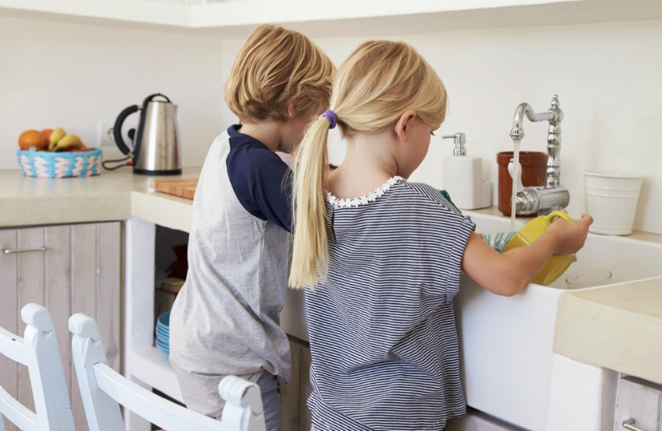

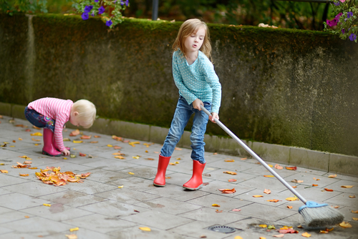
Maths at home
7. Letting children help with real jobs
– setting the table (‘We need 4 forks—can you get them?)
– tidying toys (‘Let’s put 2 in this box and 2 in that box.’)
– cooking (‘Can you pour until it’s full?’)
Your support makes a huge difference. Little and often, woven into your normal routines, will help your child feel confident and excited about maths.

Slide 18
Any questions?
Are there any examples from home — games or activities you’ve tried with your child that you’ve found work well?
Fun Maths apps and games for EYFS to support you:
- NumBots - developed for addition, subtraction, number bonds, and subitising. -
Mathseeds - Interactive touch-based activities: counting, addition, shapes, and more.
Busy Things – Maths Games - covers number recognition, counting, shape, pattern, addition, subtraction, etc.
- 1‑Minute Maths (White Rose) – focuses on building confidence in subitising, mental arithmetic, and fluency in short, manageable bursts.
- Hit the Button - A fast-paced mental maths game addressing number bonds, doubling, halving, and more.

