Slide 1
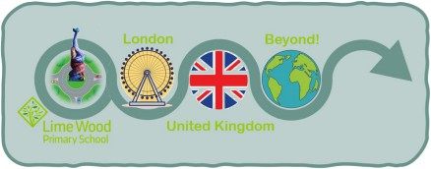




Year 2 Curriculum Overview – Spring 2
Where does our food come from?
Big Bang Day
Tuesday 24th February – We’ll explore a variety of fruits and vegetables through fun art, creative writing, and delightful sniffing activities! We will also be going to Tate Modern on Thursday 26th February to enhance our learning in art, with a particular focus on the work of Monet. We will explore his painting style, as well as his use of colour and watercolour techniques.
English
This term we will be using the text Pattan's Pumpkin to write stories based on the Indian Folktale. We will be learning the story and then changing elements to create our own versions. We will also be completing a piece of non-fiction writing using the book Handa's Surprise as a stimulus.
Maths
This term pupils will be learning about fractions, measurement and statistics. We will be consolidating our learning around the four operations.
Humanities
The Science focus this term will be around plants. We will be looking at parts of plants, what plants need to survive and plant lifecycles.
Art
In Art we will be developing our painting skills. We will be exploring primary, secondary and tertiary colours while exploring the work of Monet. We will be applying our learning by creating a water colour representation of Monet's work.
Music
In Music, we will have a Music Food Fest. We will be learning new songs about food, whilst looking at different sounds instruments make. Finally, we will be listening out for changes in pitch and learning about the structure of a song.
Computing
In Computing we will be learning how to use a search engine to collect data. We will be creating a presentation about food based on the information we find.
Religious Education
The focus question for RE this term is 'How and why do we celebrate sacred and special times?. We will be looking at how people from different religions celebrate their special times while discussing how we celebrate special times.
Physical Education
In PE, the children will be focussing on continuing to develop their fundamental skills. In addition, they will be learning striking and field games.
This term the focus is on Independence and Resilience. Pupils will focus on independence in their learning and the importance of working hard and how it will support them later in life.
Personal Development

