Slide 1


BrightBites
Registered charity 1075826

Slide 2
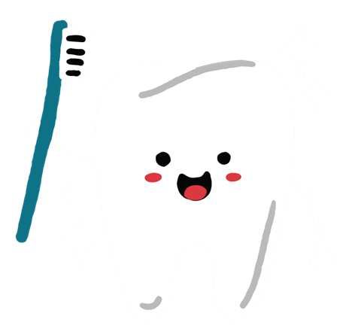
All about our teeth
We have 20 primary teeth that we need to brush and protect.
Why do we need our teeth?
We need our teeth to eat, talk, sing, and smile!

Slide 3
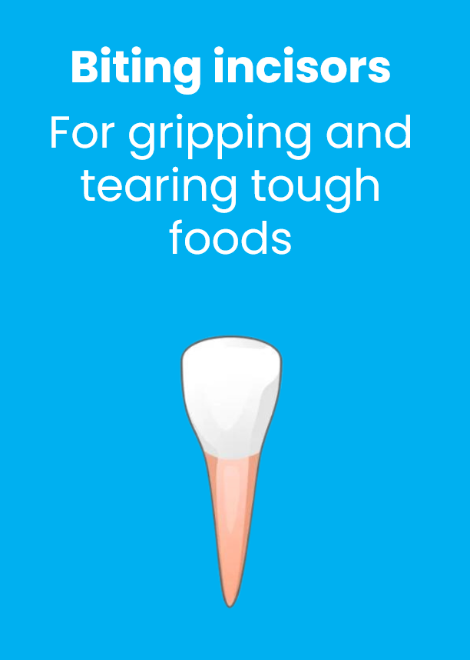
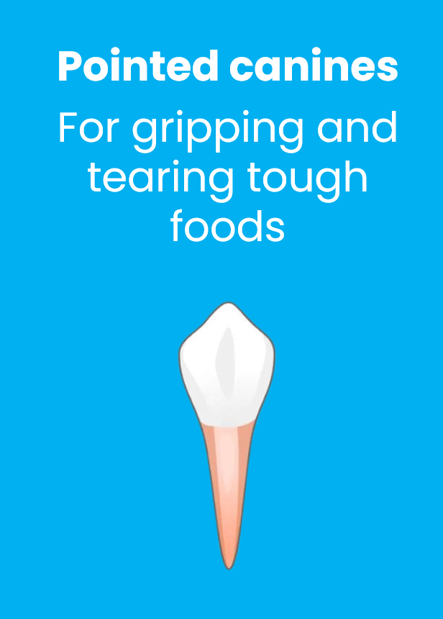
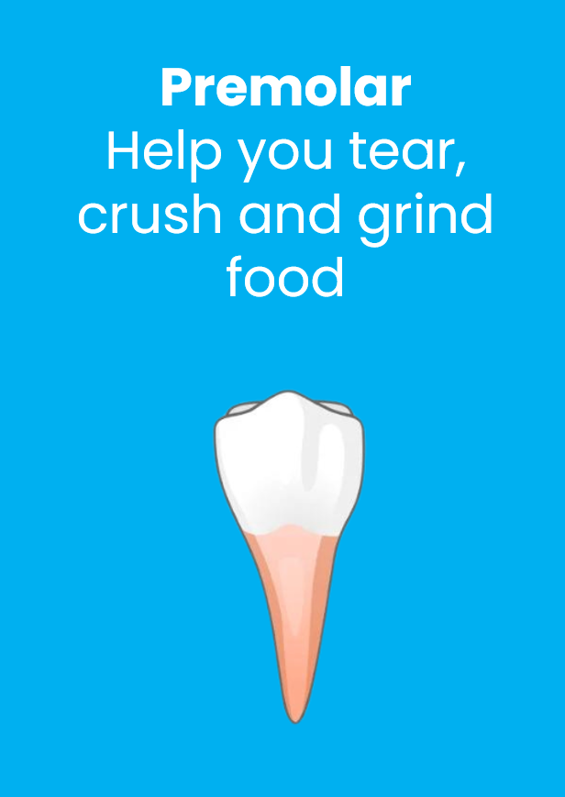
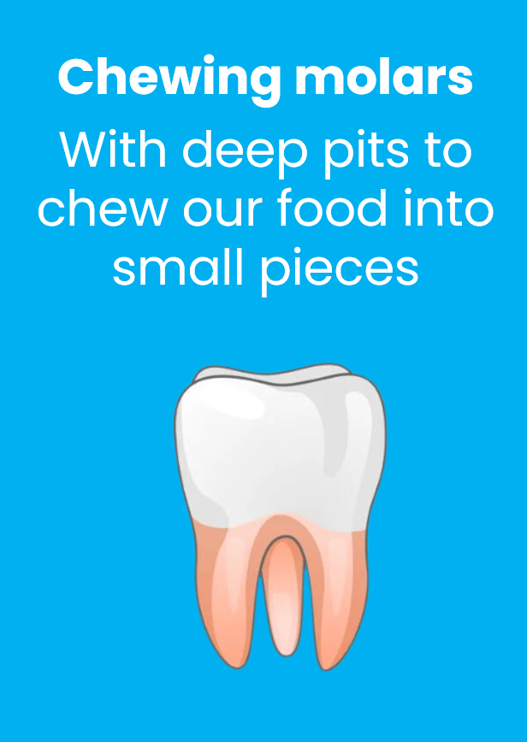
Our teeth are all different shapes and sizes
Biting incisors
For gripping and tearing tough foods
Pointed canines
For gripping and tearing tough foods
Premolar
Help you tear, crush and grind food
Chewing molars
With deep pits to chew our food into small pieces

Slide 4


Brushing our teeth
Morning
Brushing your teeth after breakfast cleans away any leftover food and plaque.
Plaque is a sticky coating which is made up of germs.
Morning brushing means you can start the day feeling fresh and clean!
Night
Brushing your teeth at night can help remove food particles and bacteria.
Brushing before bed is important, as it protects your teeth while you sleep.

Slide 5
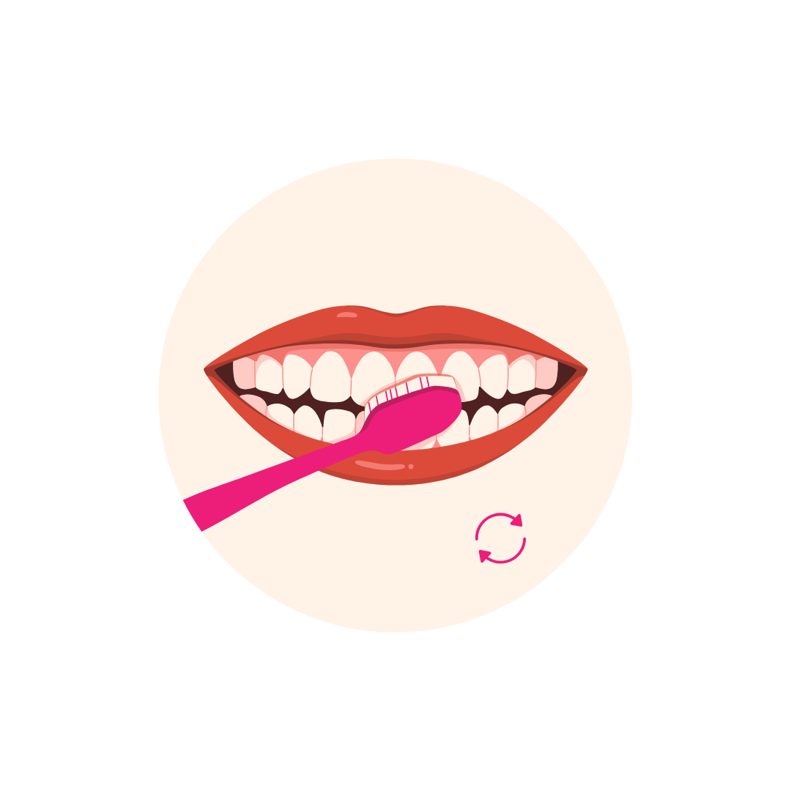
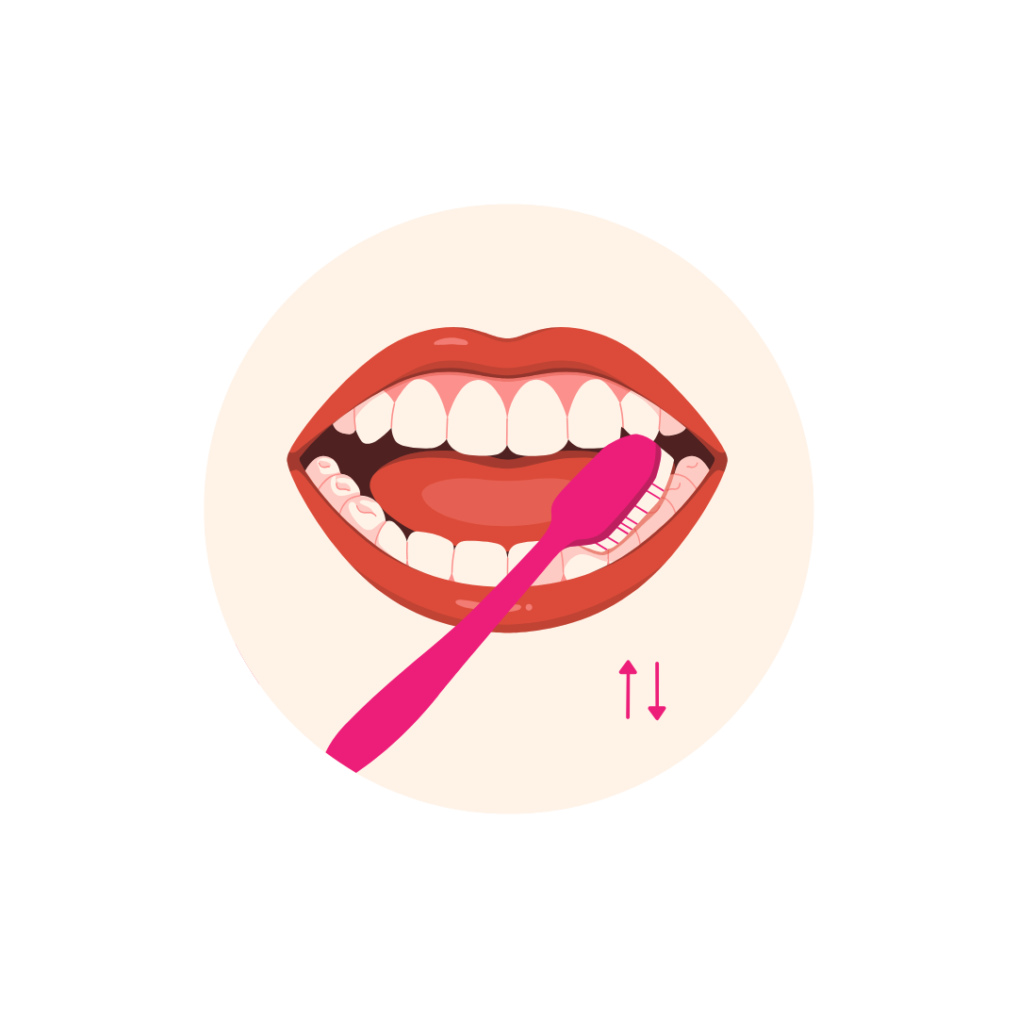


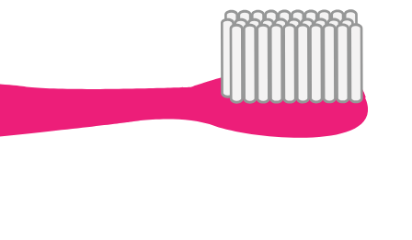
How to brush our teeth
Use a
pea-sized amount of toothpaste
Brush in little circles including your gums
Brush the front, back, and tops of all your teeth
Brush for 2 minutes then spit.
Don’t rinse the paste away!

Slide 6


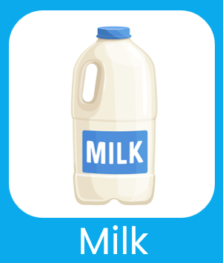
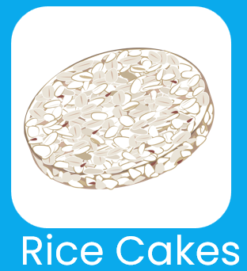


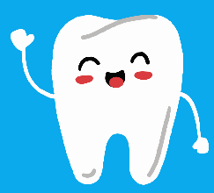
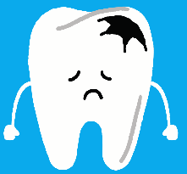


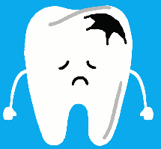
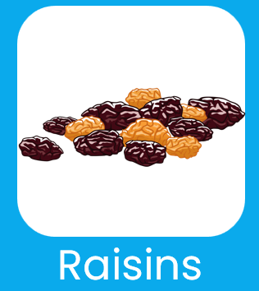

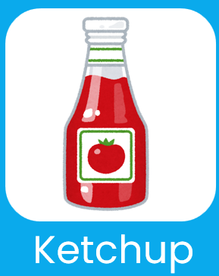
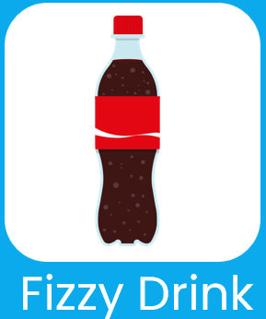
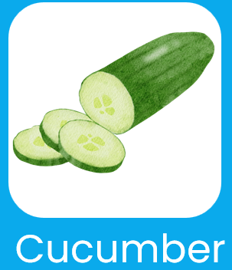
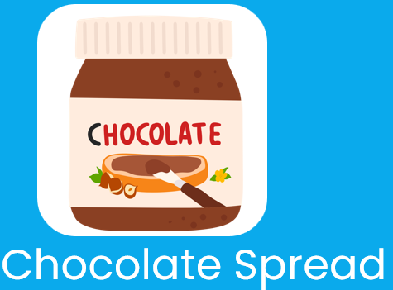
Food and drink choices
Can you give a thumbs up if you think the food or drink choices are good for our teeth, and a thumbs down if you think they could damage our teeth?

Slide 7
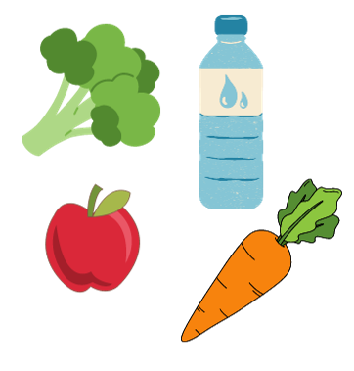
Healthy foods
Healthy teeth are happy teeth!
Eat fruit and vegetables to keep your teeth strong.
Choose healthy snacks like cheese, yogurt, apples and bananas.
Also drink water and milk.

Slide 8
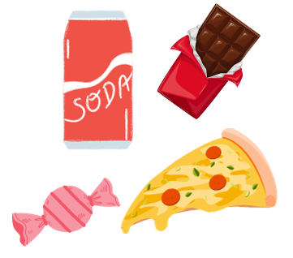
Unhealthy foods
Sugar is harmful for both our teeth and health. Too much can cause holes in your teeth, these are called cavities.
Treats on occasions are fine, but avoid eating lots of sweets, fizzy drinks and sugary snacks.

Slide 9
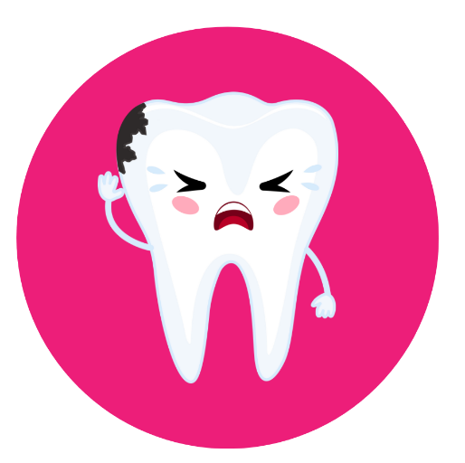
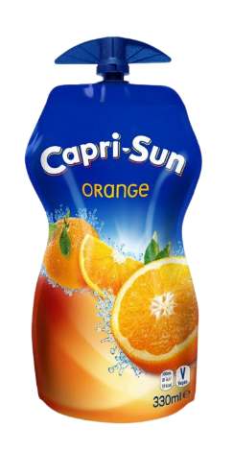
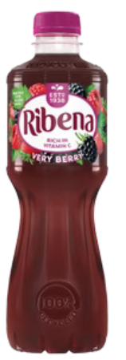
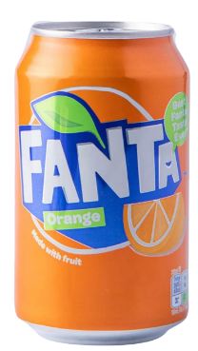
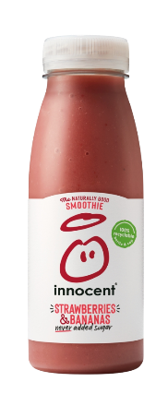
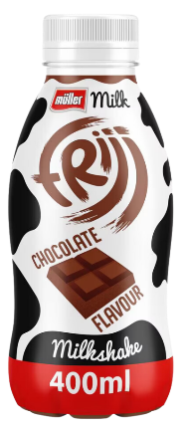
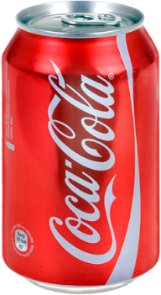
How much sugar is in drinks?
Capri Sun (330ml)
Fanta(330ml)
Ribena
(500ml)
Consuming Soft drinks is one of the main causes of tooth decay.
Carbonation, sugar and acids in soft drinks weaken tooth enamel and encourage the growth of bacteria that contribute to tooth decay.
Whilst some fruit-based drinks do not have added sugar, they should still be consumed in moderation.
4
4
6
Smoothie (250ml)
Coca Cola (330ml)
Milkshake
(400ml)
6
10
11

Slide 10
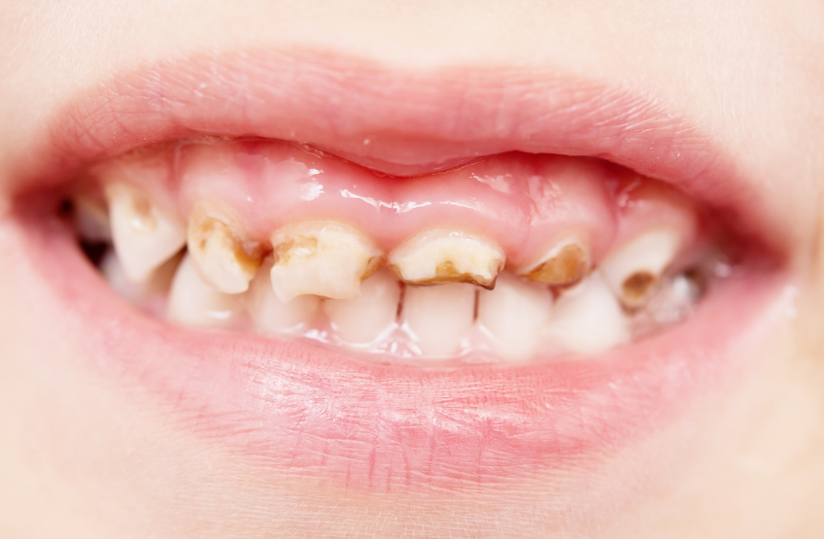
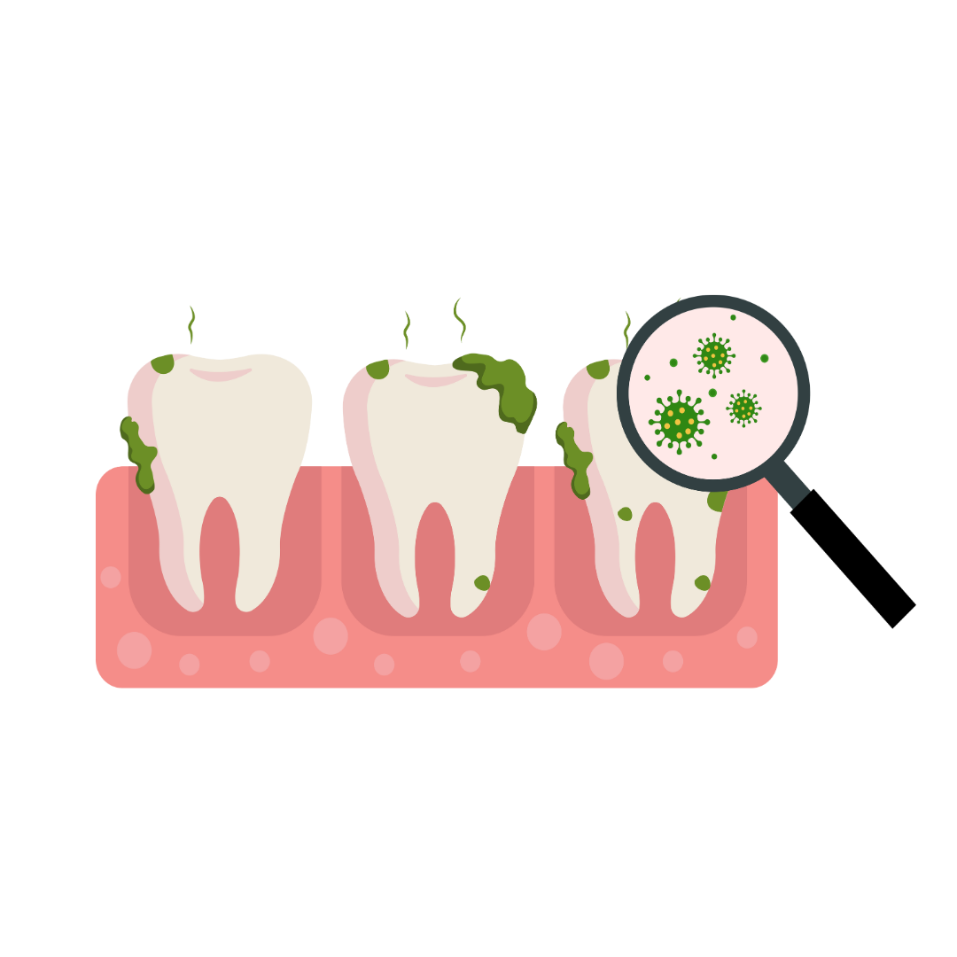
What will happen to my teeth if I don’t look after them?
Without good oral health teeth will begin to decay and rot which can be painful.
If they get really sore a dentist might have to give you a filling or take the bad tooth out which is called an extraction.

Slide 11
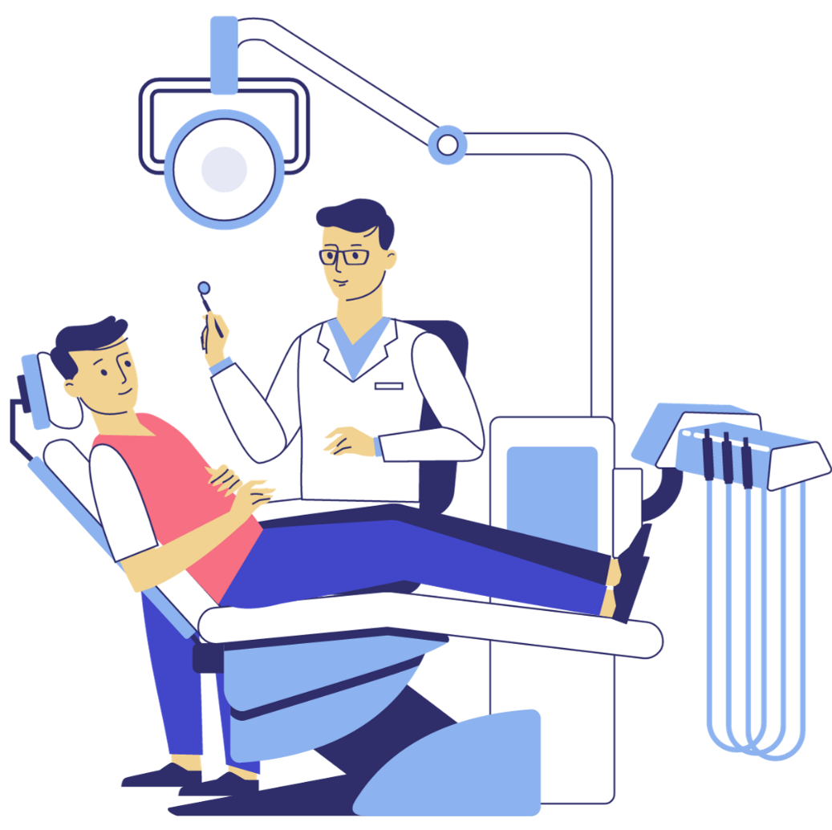
Visiting the dentist
Why do I need a dental check-up?
A check-up allows your dentist to see if you have any dental problems and helps you keep your mouth healthy.
Leaving problems untreated could make them more difficult to treat in the future, so it's best to deal with problems early, or, if possible, prevent them altogether.

Slide 12
Remember...
Brush your teeth twice a day, for 2 minutes.
Use a pea-sized amount of toothpaste. Make sure you brush every bit of each tooth – front and back, top and bottom!
Don’t forget your gums too. Do not rinse your mouth.
Make healthy food & drink choices, a treat is ok – but not too often!
Visit the Dentist for a check-up, to make sure your mouth, teeth and gums are all healthy.

Slide 13

Thank you for listening.

